Slide 1
Not Van Halen
(BAND)
Logo

Slide 2
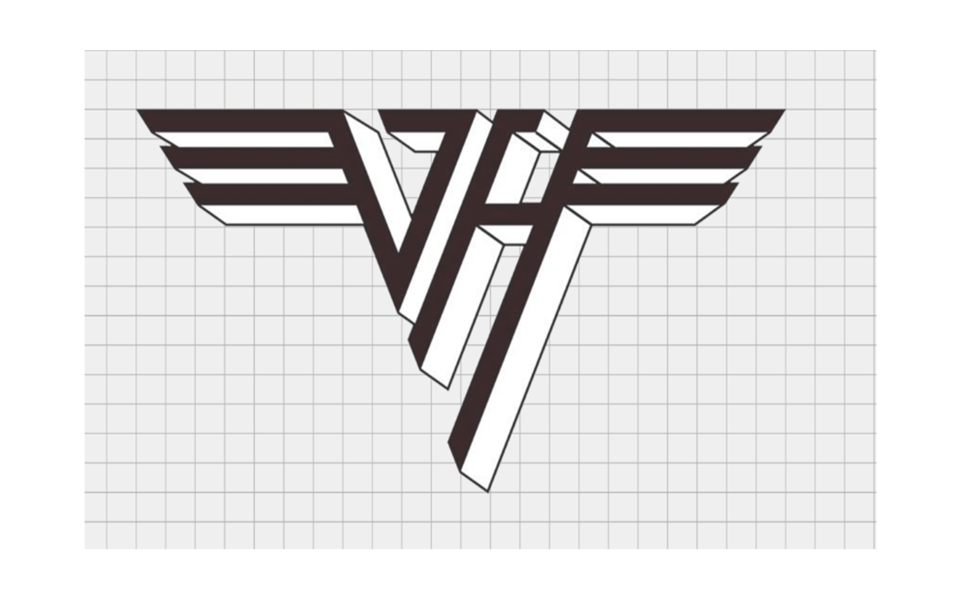
Van Halen Logos

Slide 3
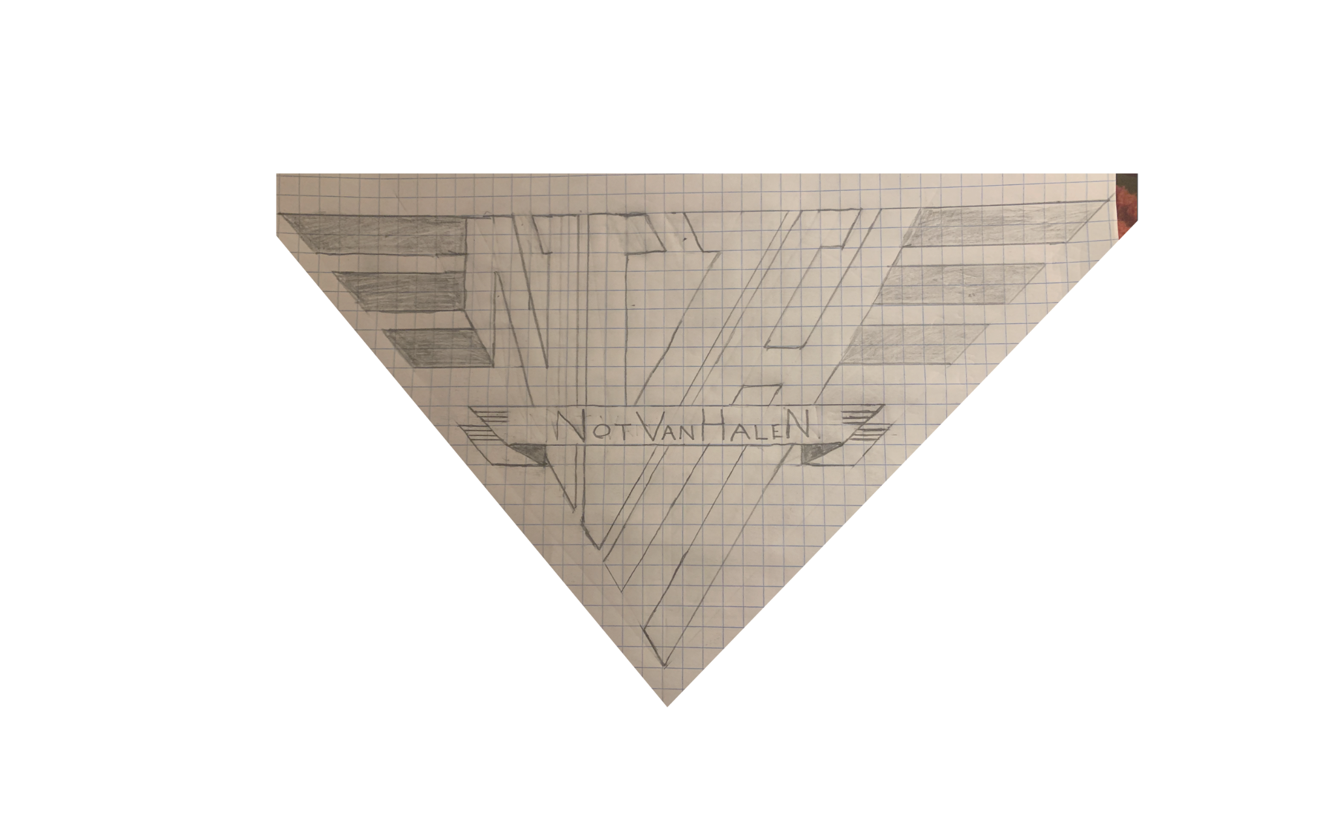
Sketch

Slide 4
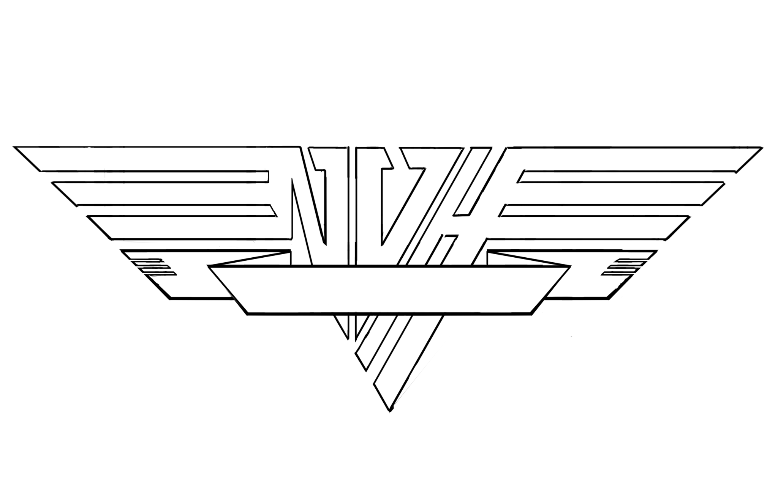
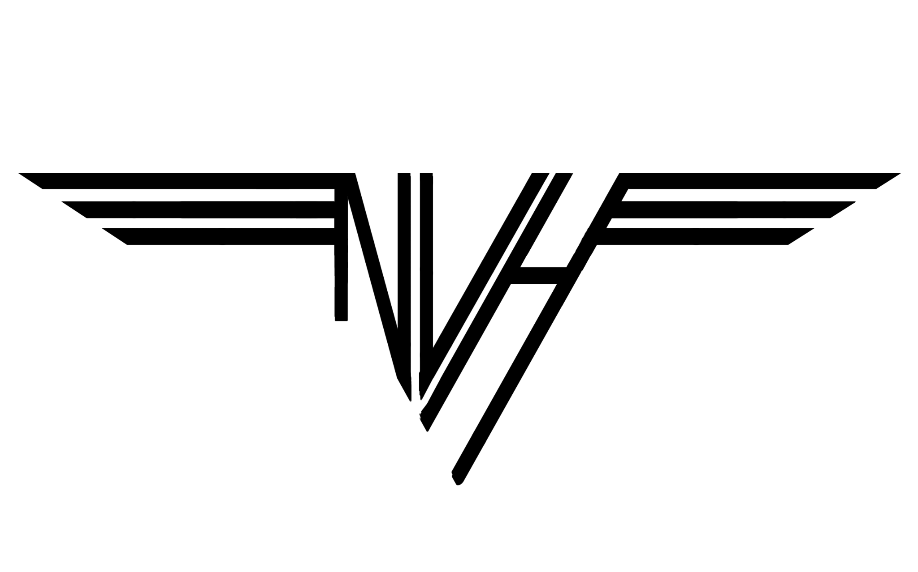
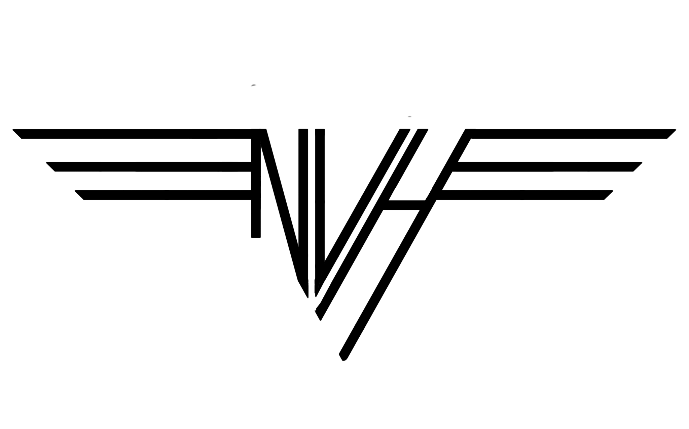
Process

Slide 5
Process - (Main) B&W logos

Slide 6
Process - (Main) B&W logos

Slide 7
Not Van Halen
(BAND)
Logo

Slide 12
Main - Black & White

Slide 15
Type
Font: Gill Sans Light Shadowed

Slide 16
Lion

Slide 17
Lion w/ Type

Slide 18
Lion

Slide 19
LINK
https://drive.google.com/drive/folders/15IfNbVoazBhblDmrQqBjYqBUf3c4tC86?usp=drive_link

