Slide 1
Fake Pockets
(BAND)
SHIRT DESIGN

Slide 2
Pocket Logo - Black & White
#1

Slide 3
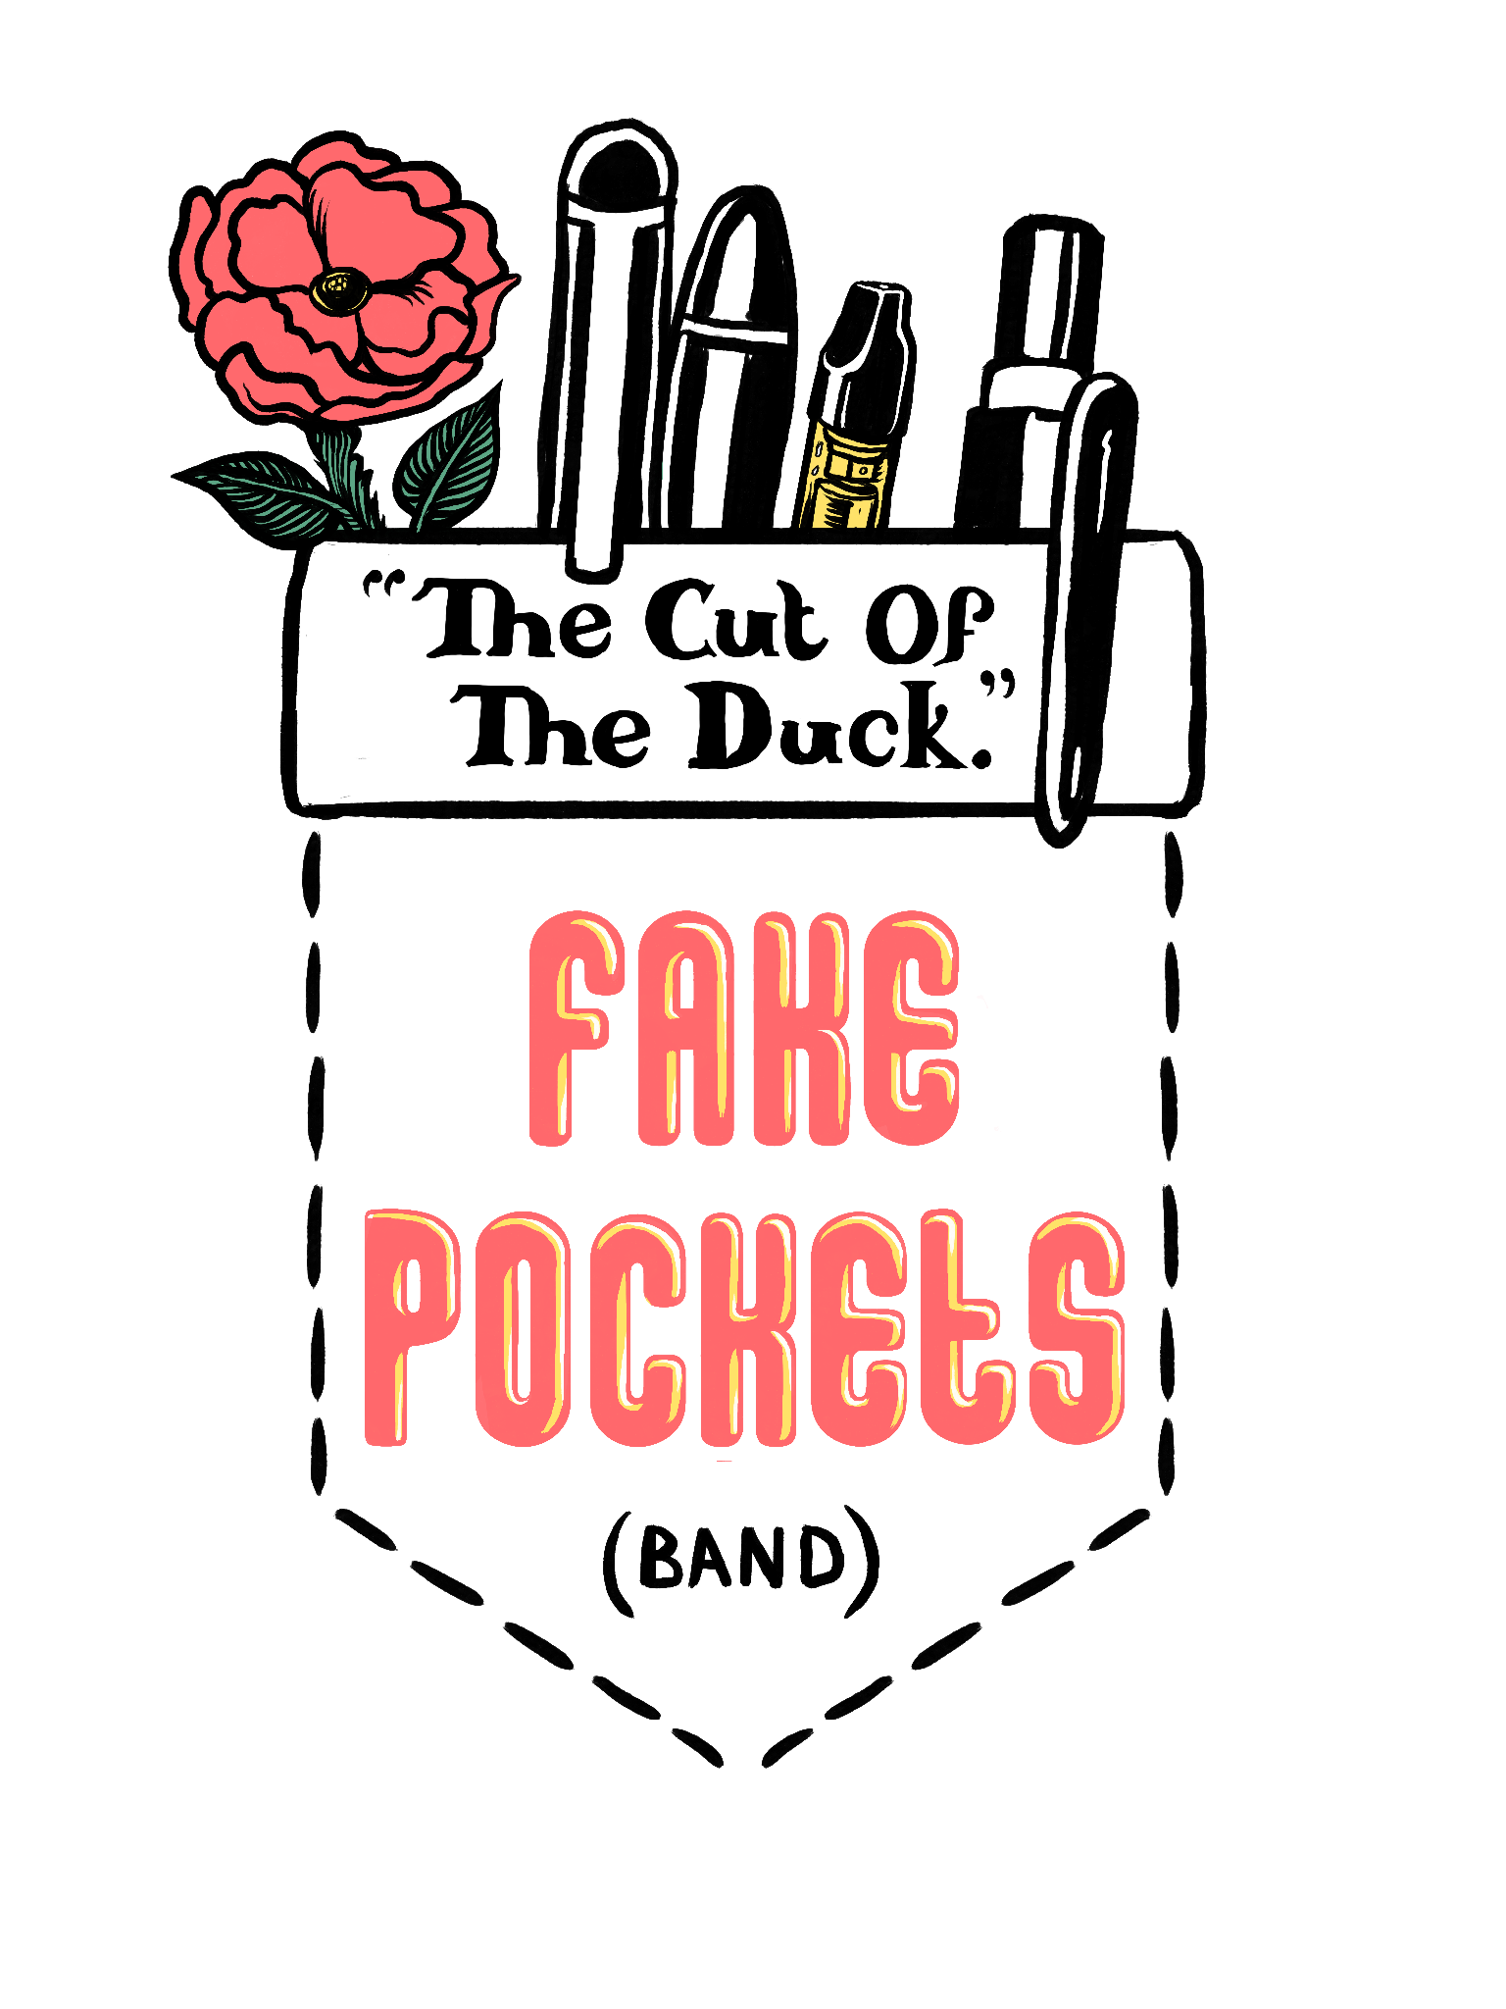
Pocket Logo - Color
#2
#3
#4

Slide 4
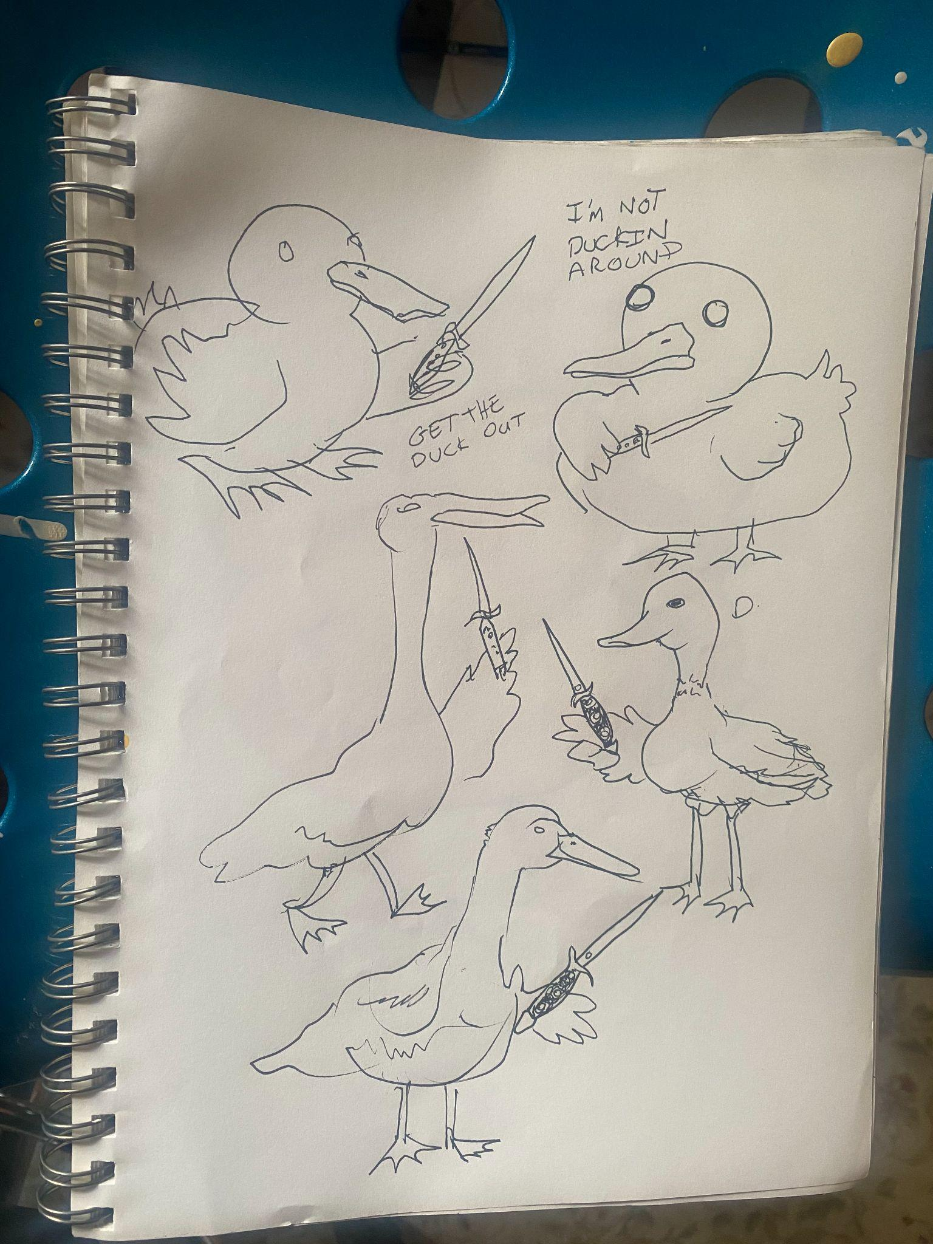
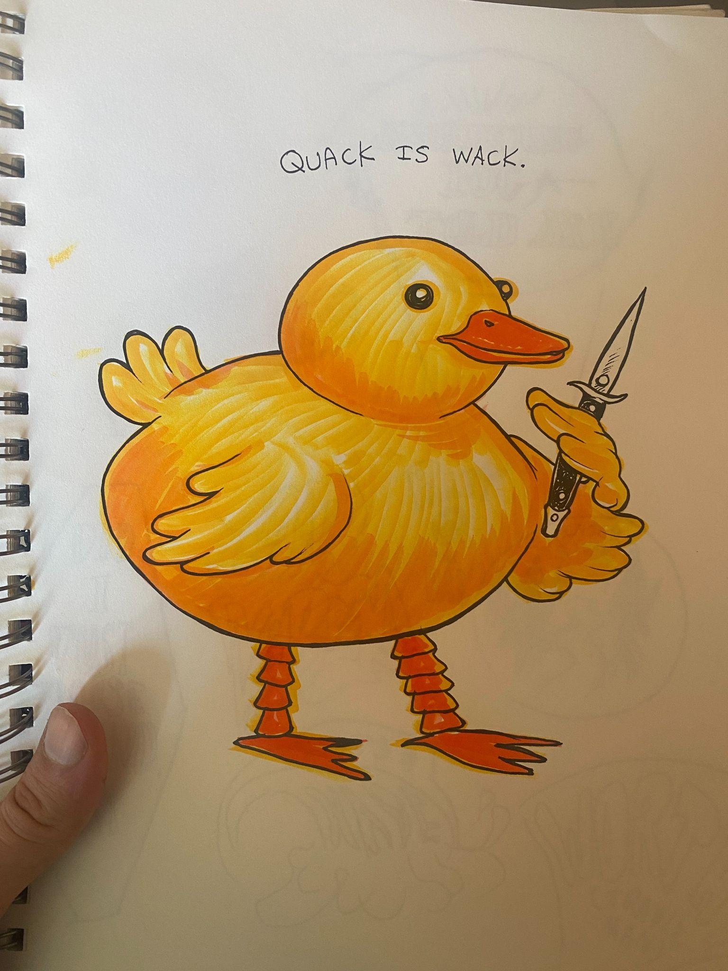
Sketches

Slide 5
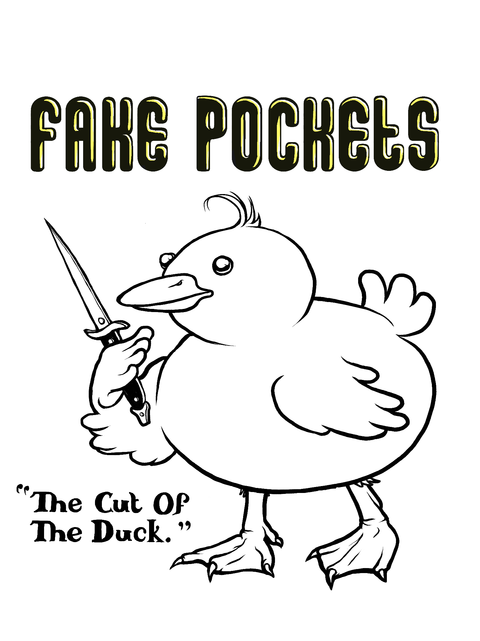
Duck - Black & White
#5

Slide 6
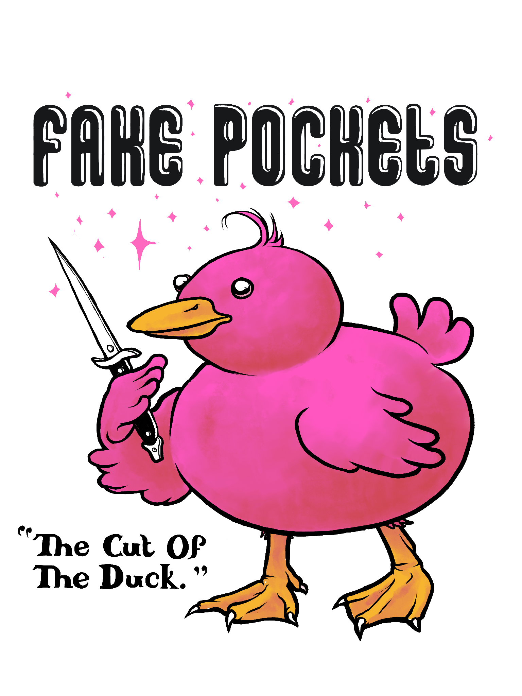
Color Duck - Black & White Type & w/Highlight
#7
#6

Slide 7
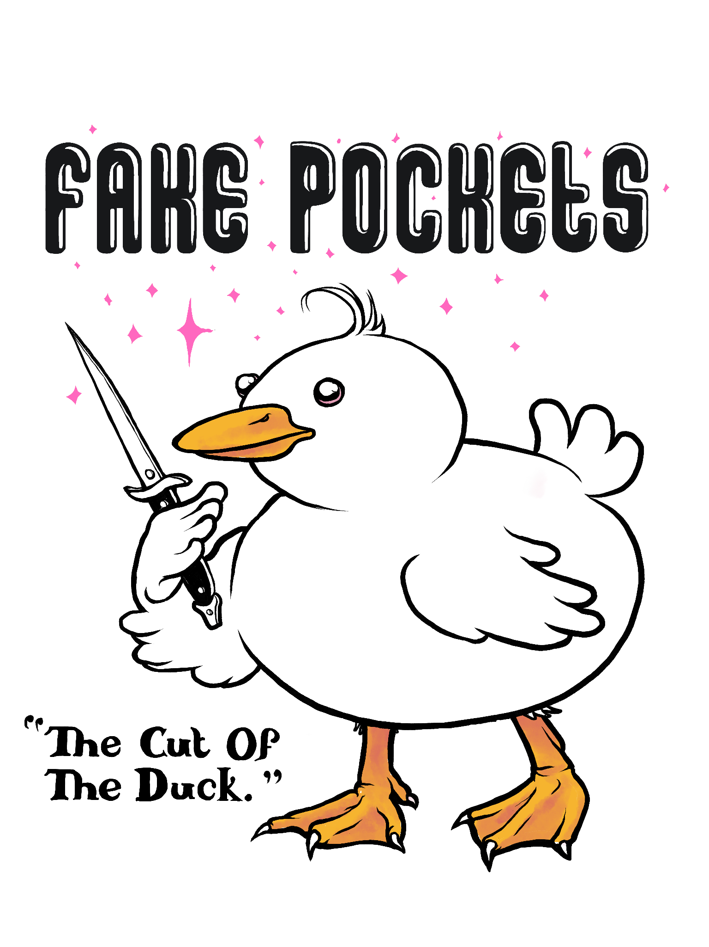
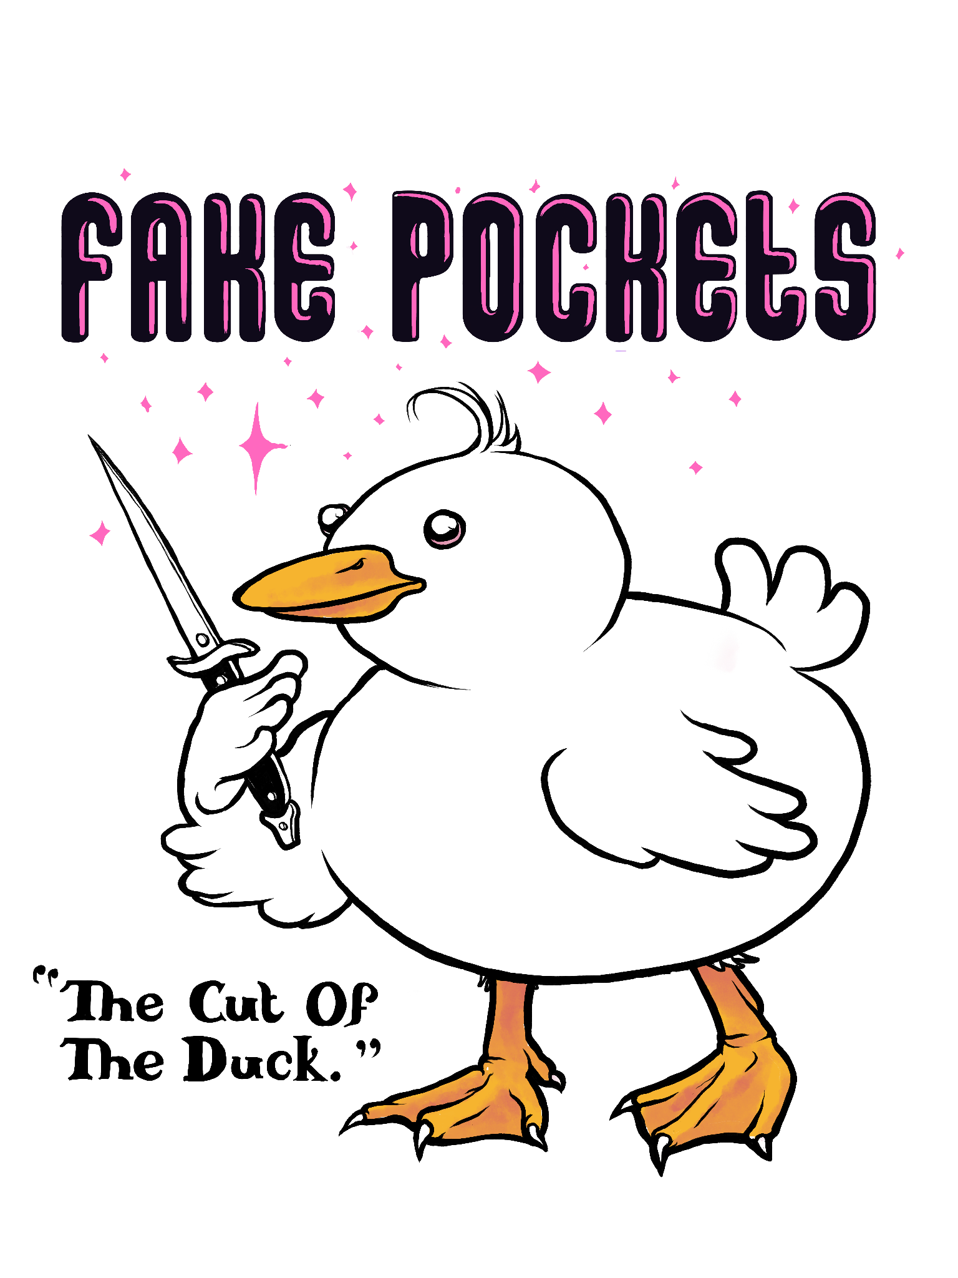
Color Duck - Black & White Type & w/Highlight
#9
#8

Slide 8
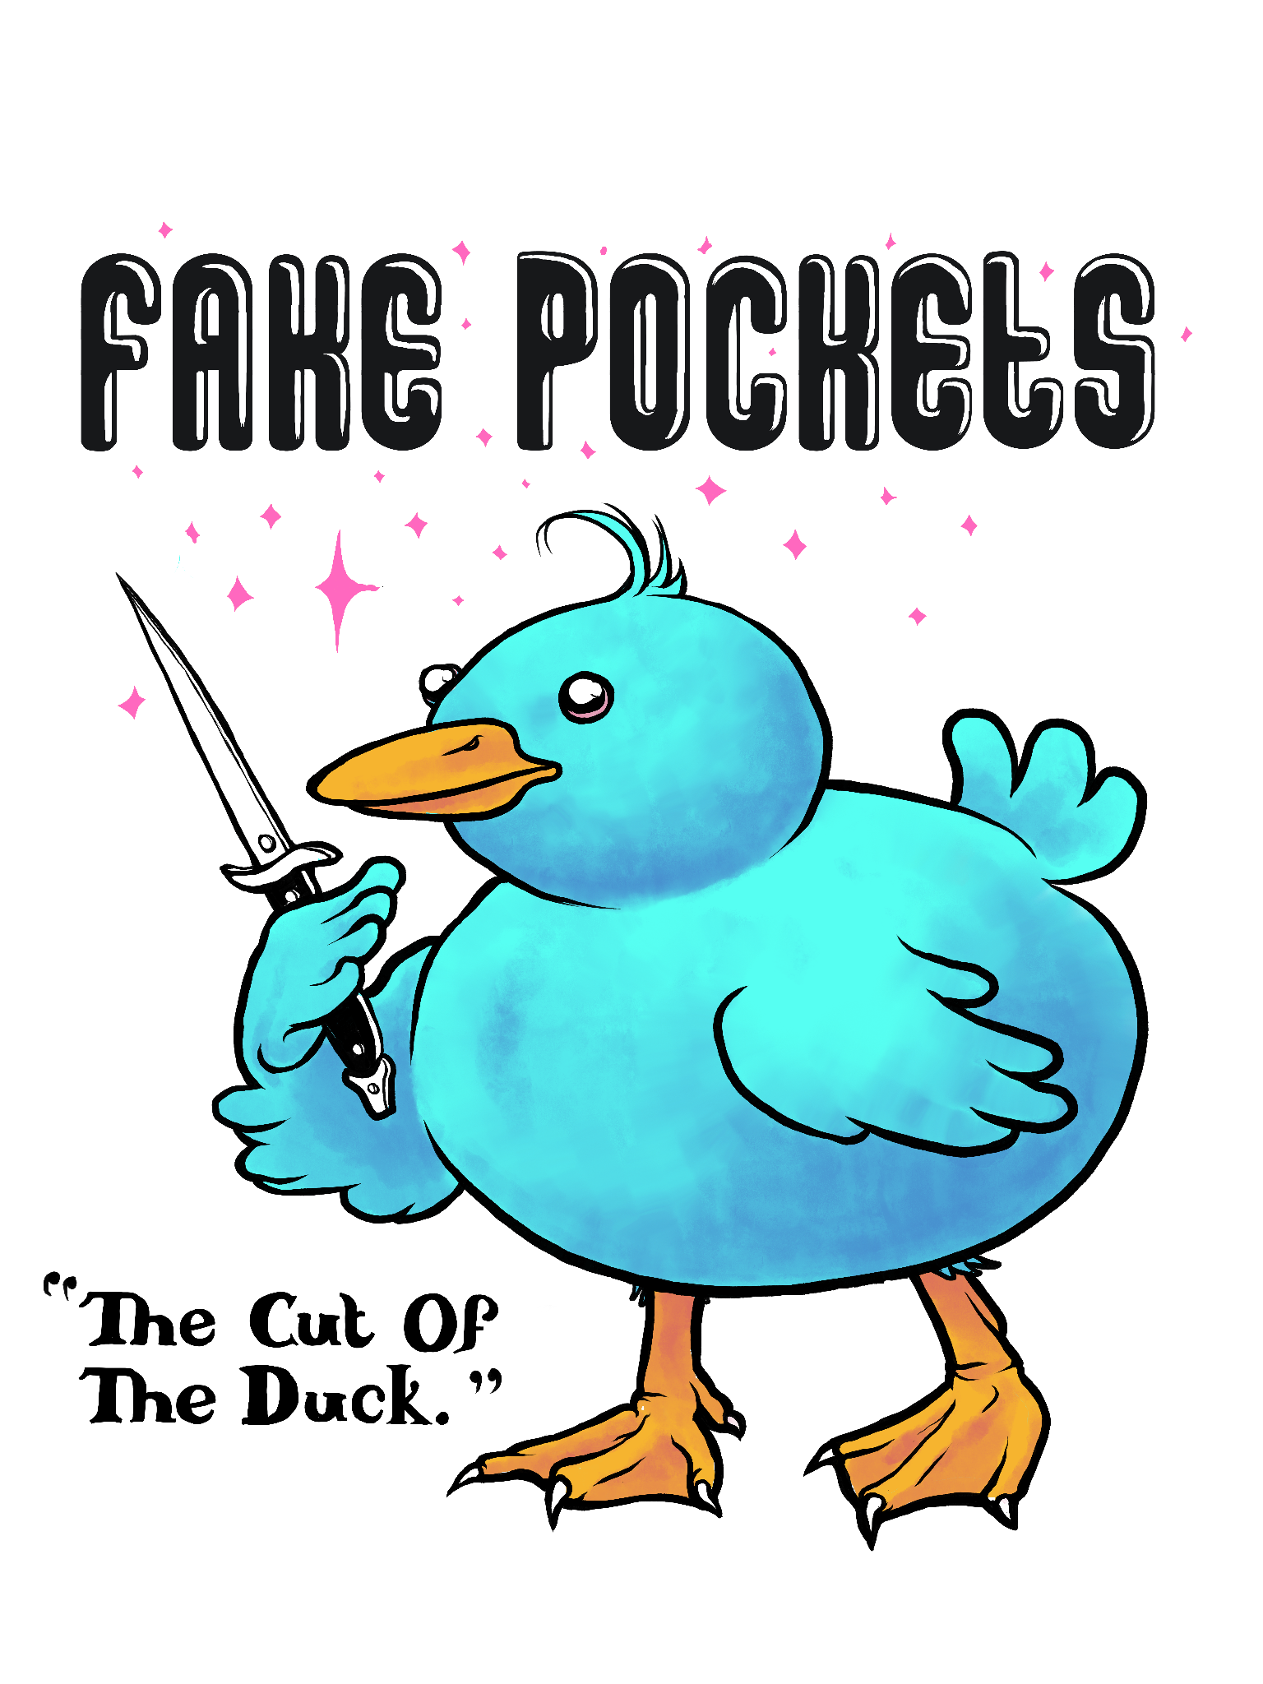
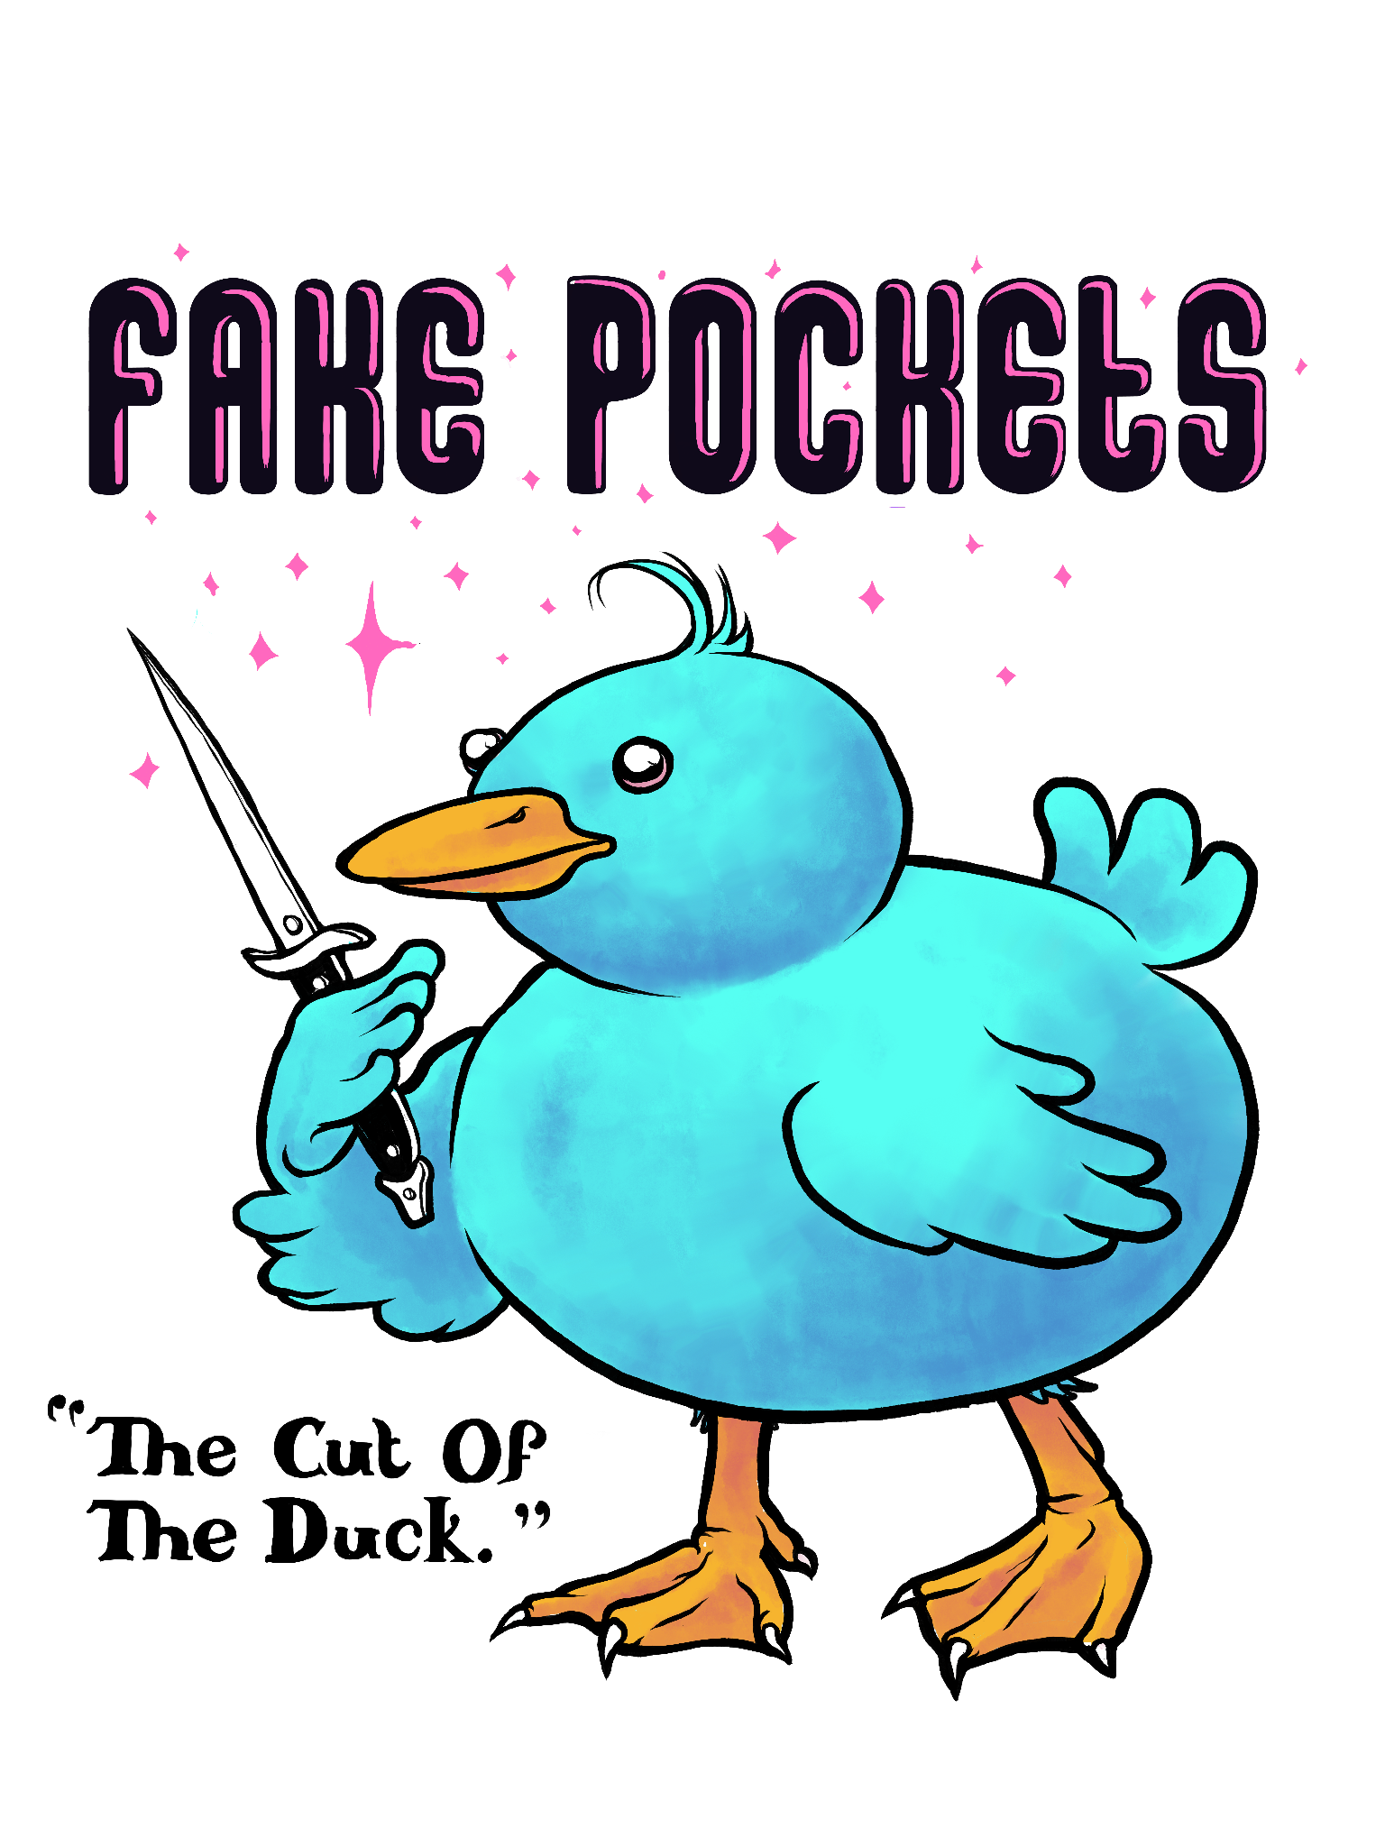
Color Duck - Black & White Type & w/Highlight
#11
#10

Slide 9
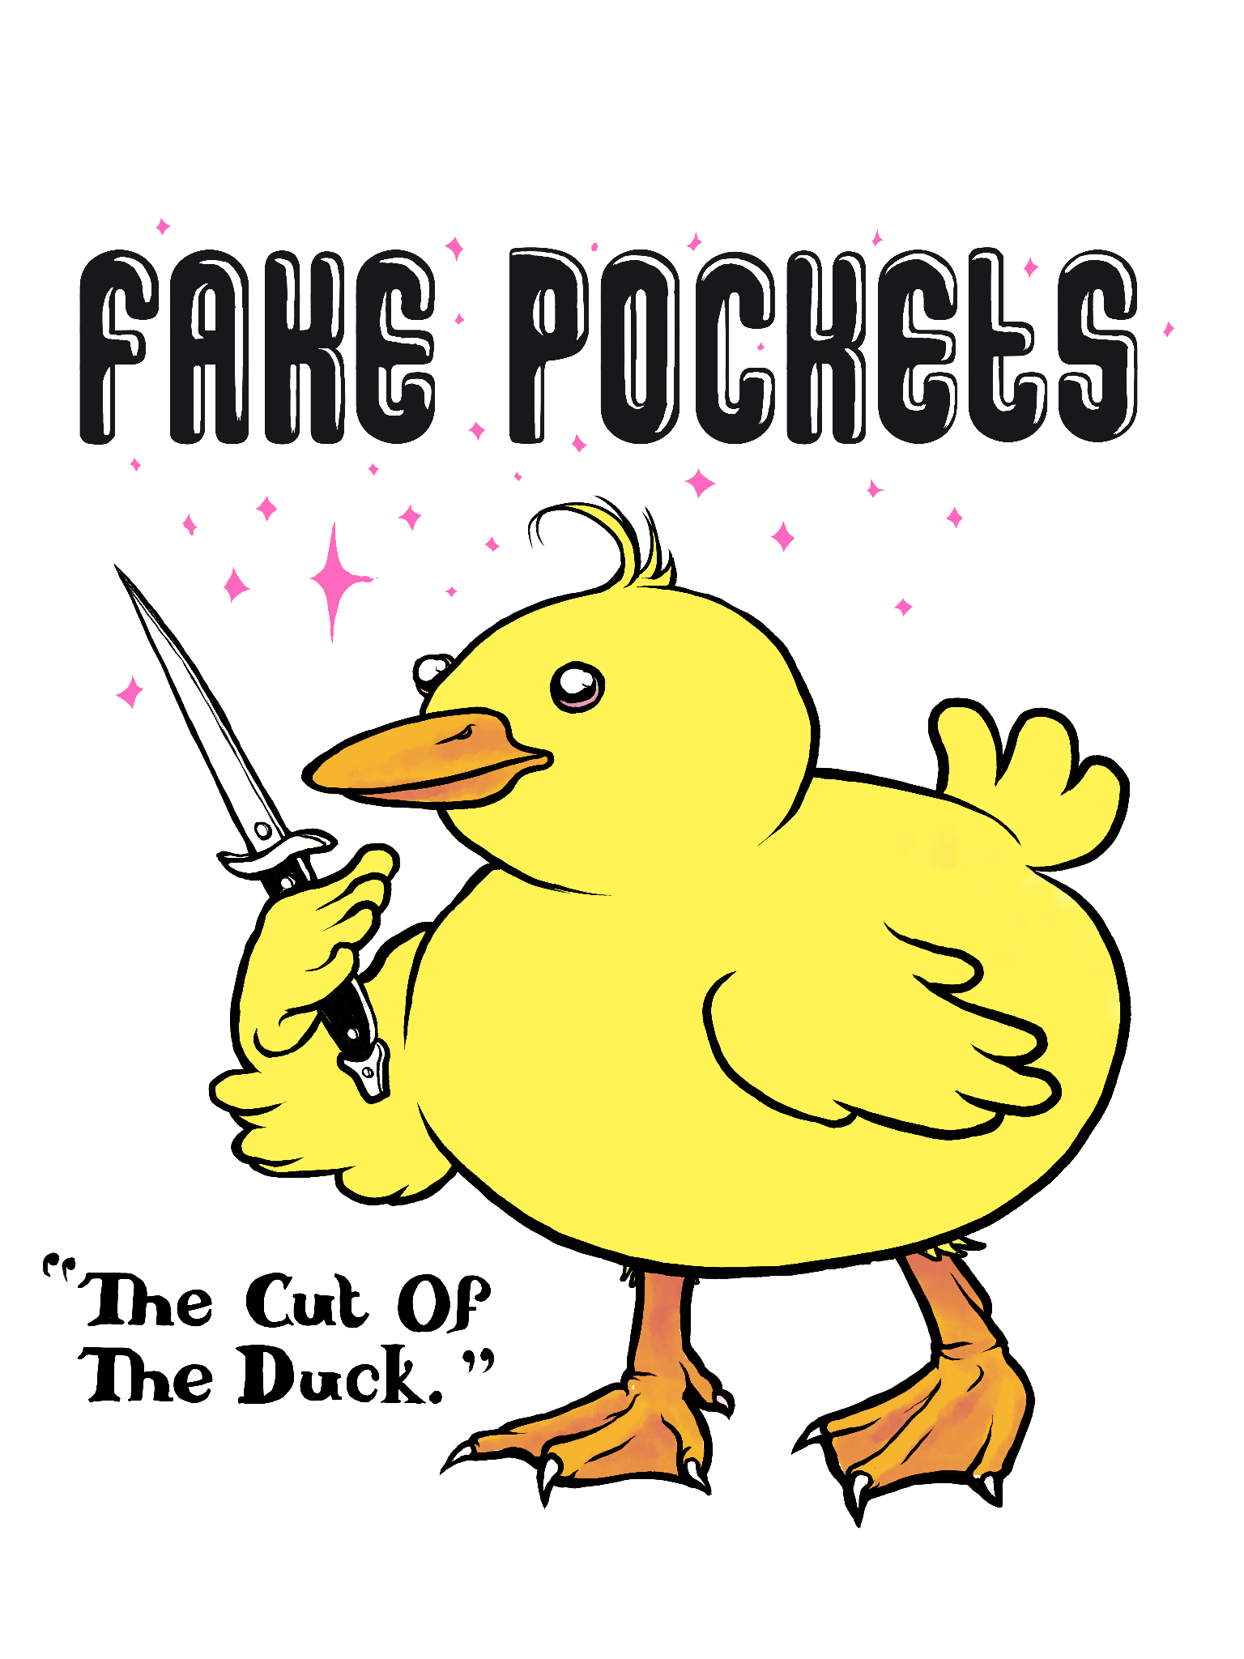
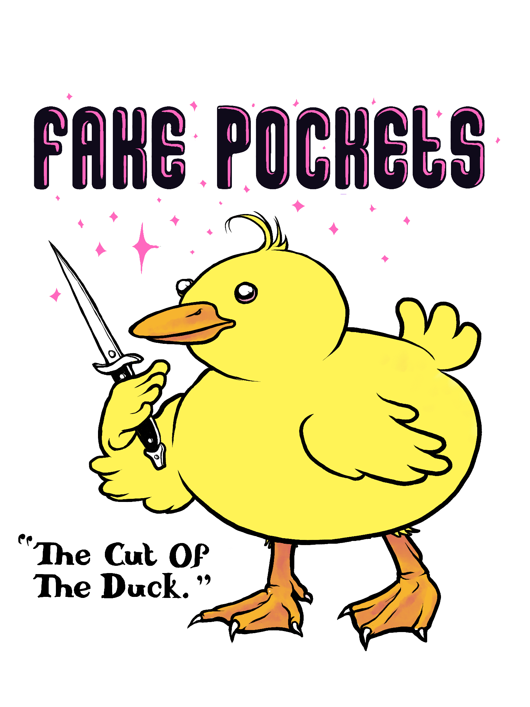
Color Duck - Black & White Type & w/Highlight
#13
#12

Slide 10
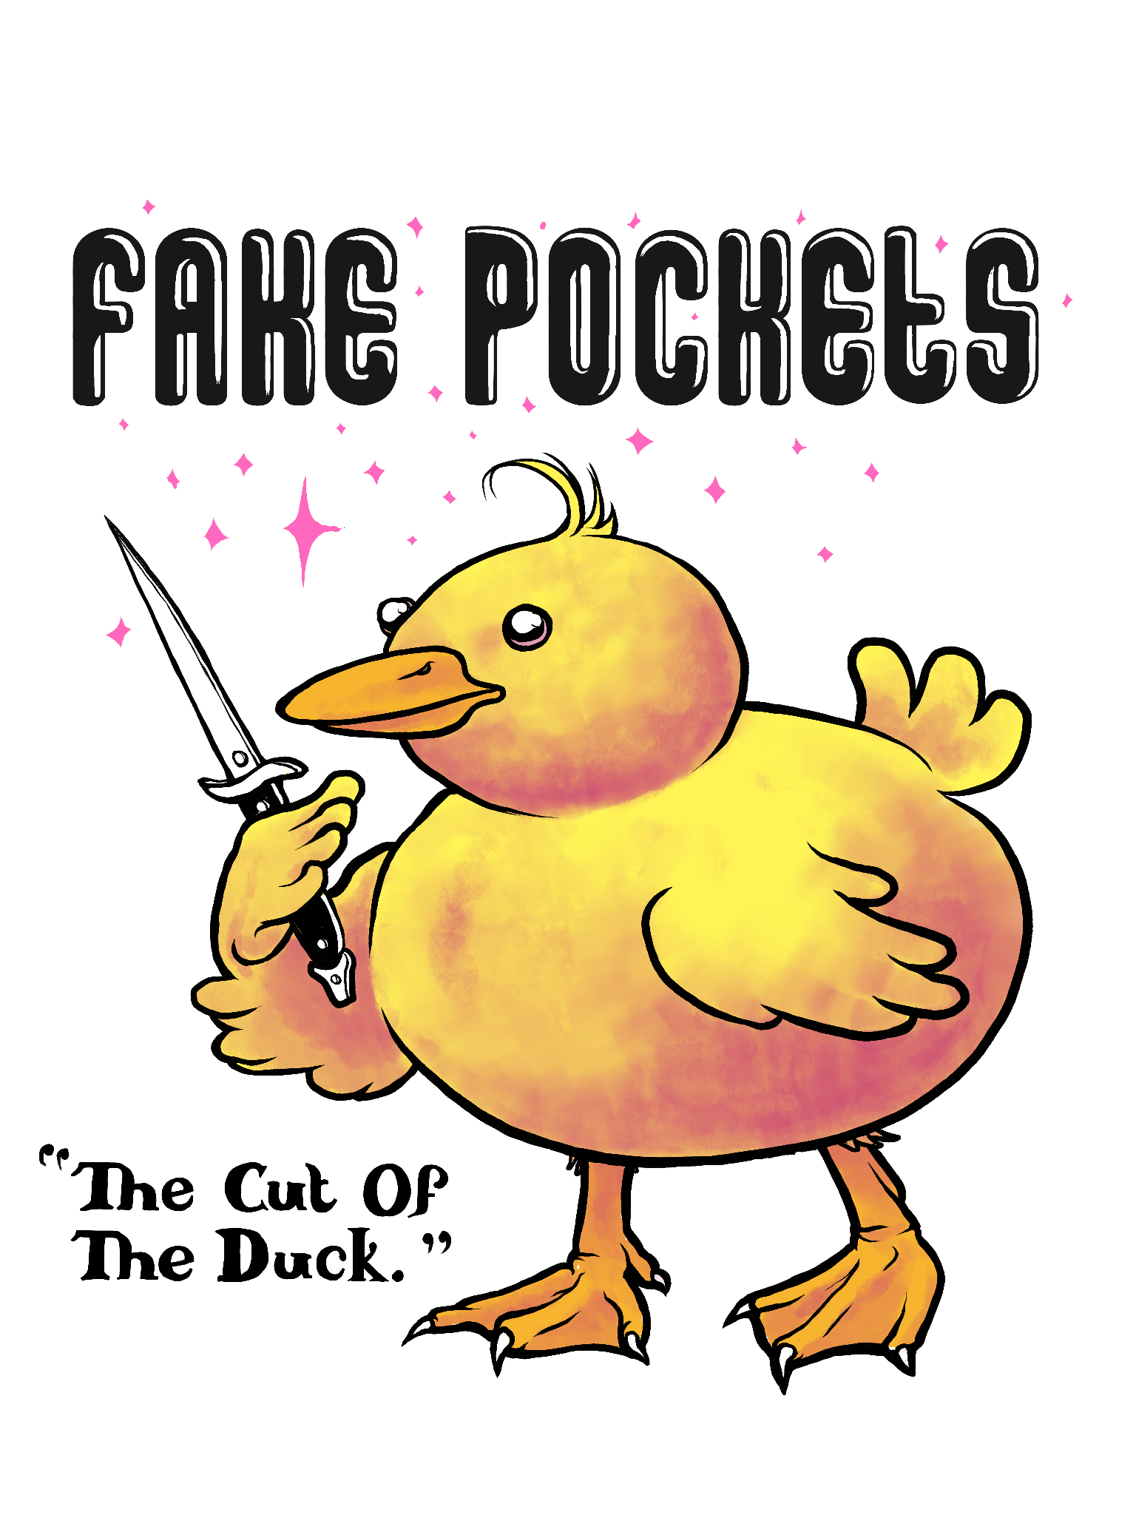
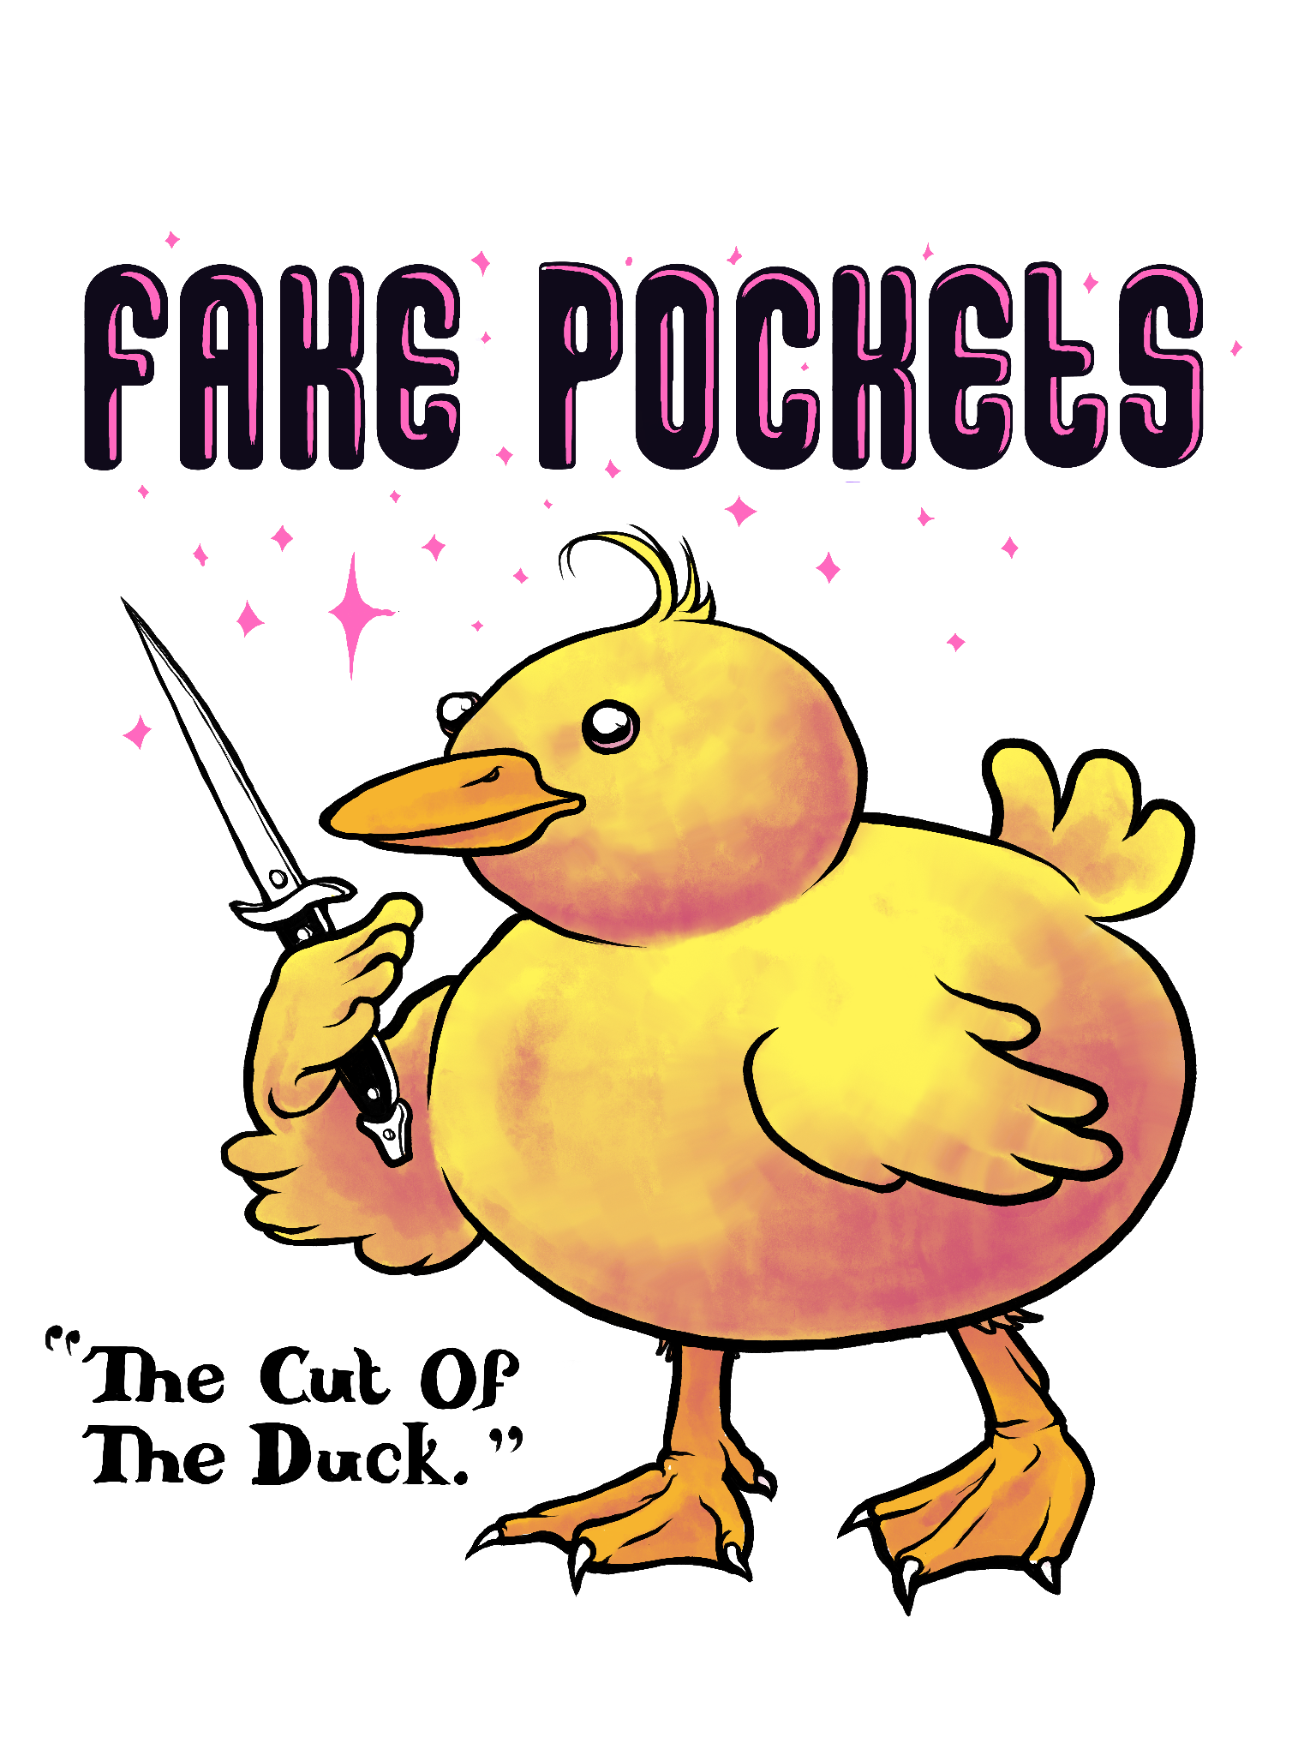
Color Duck - Black & White Type & w/Highlight
#15
#14

Slide 11
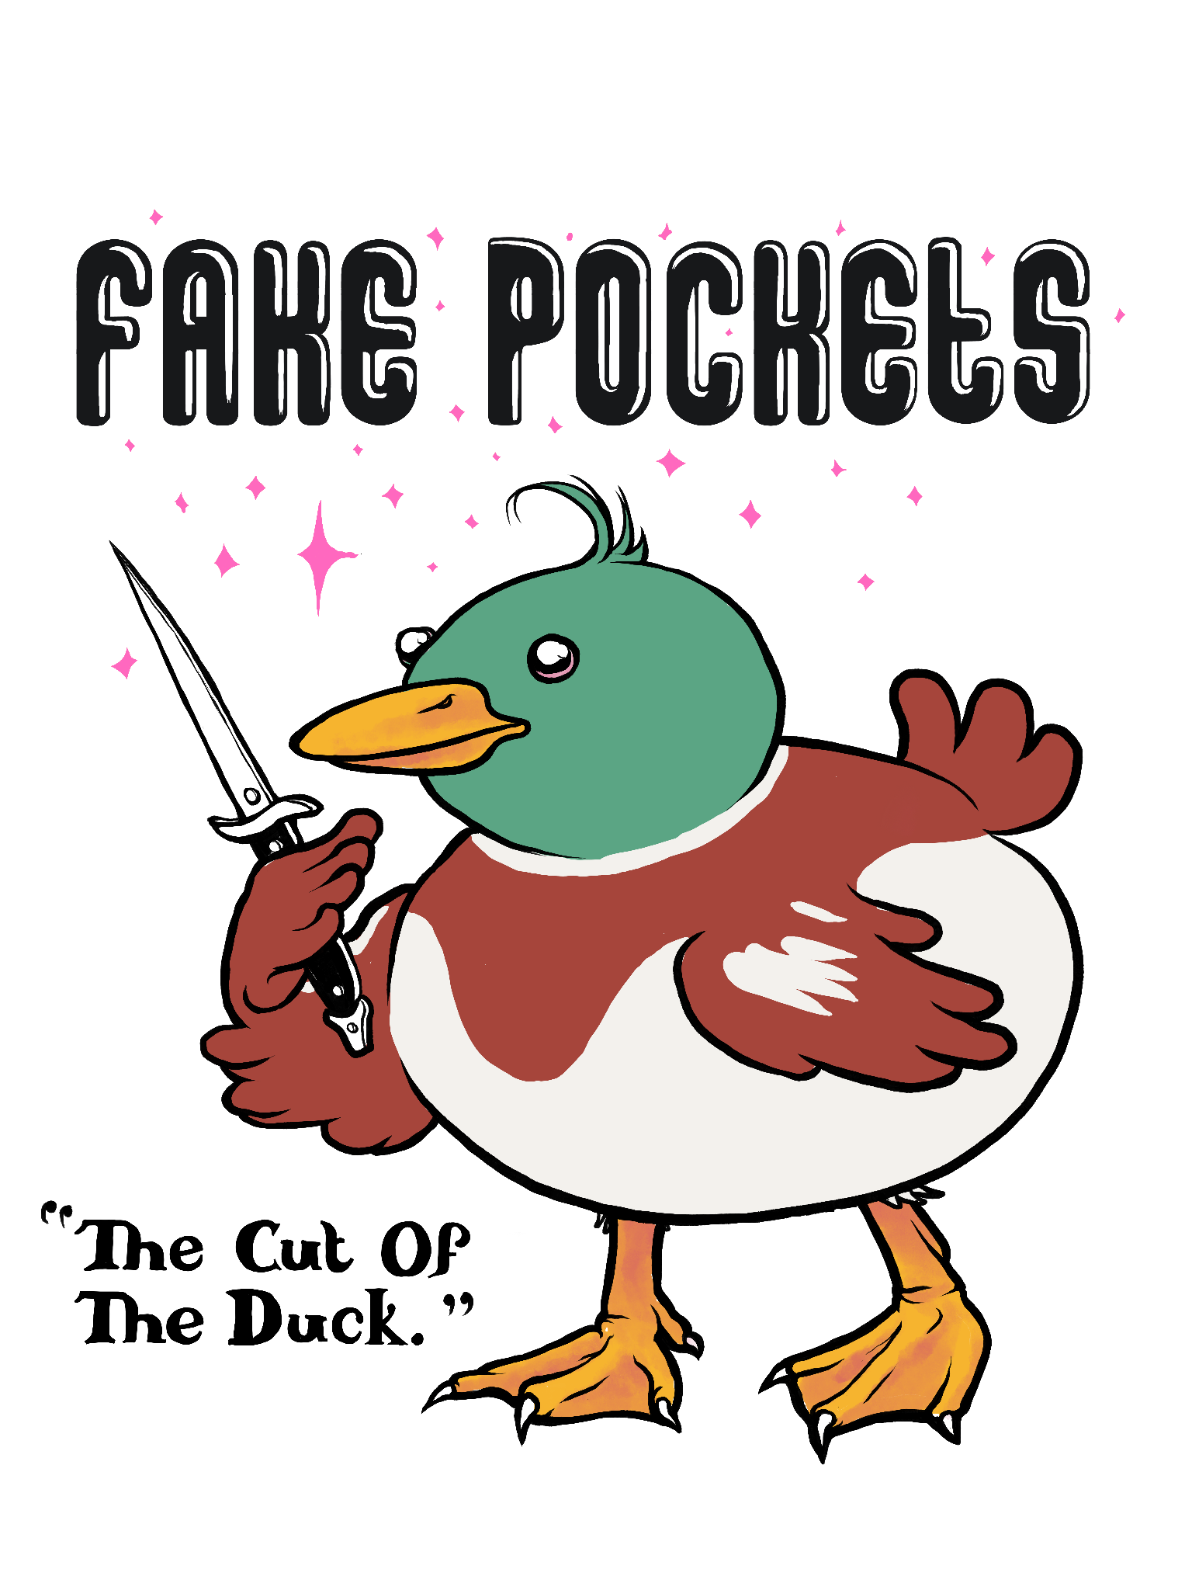
Color Duck - Black & White Type & w/Highlight
#17
#16

Slide 12
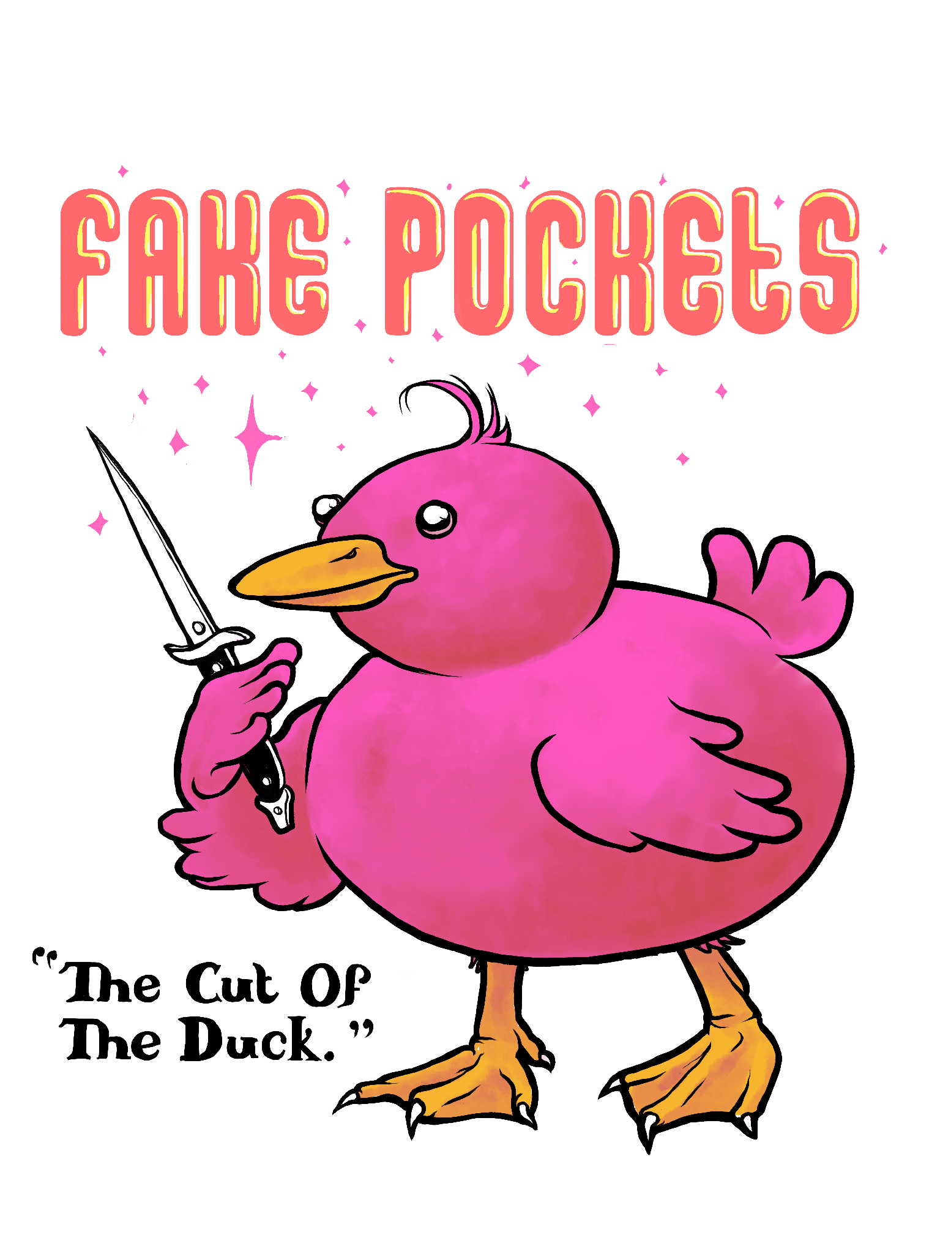
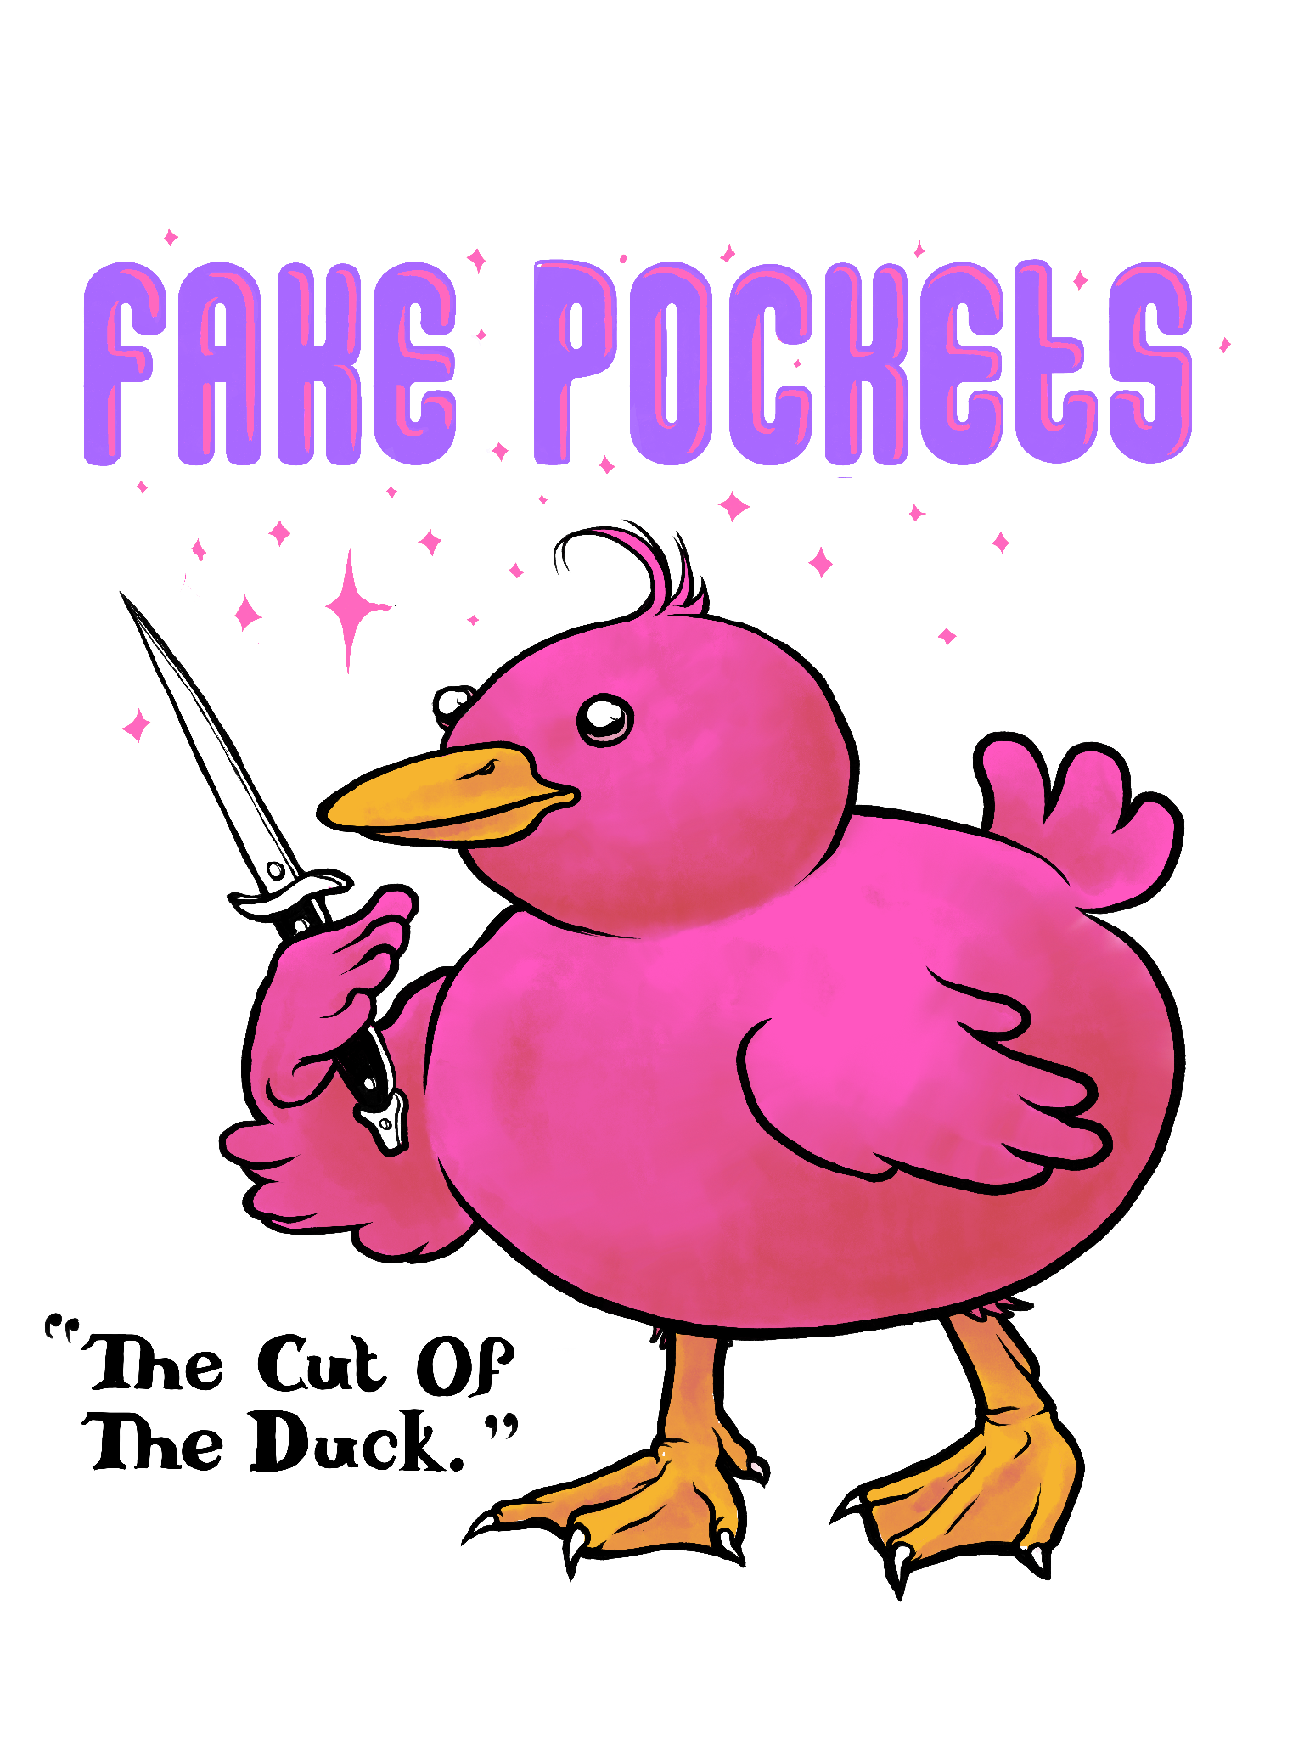
Color Duck - Color Type
#19
#18

Slide 13
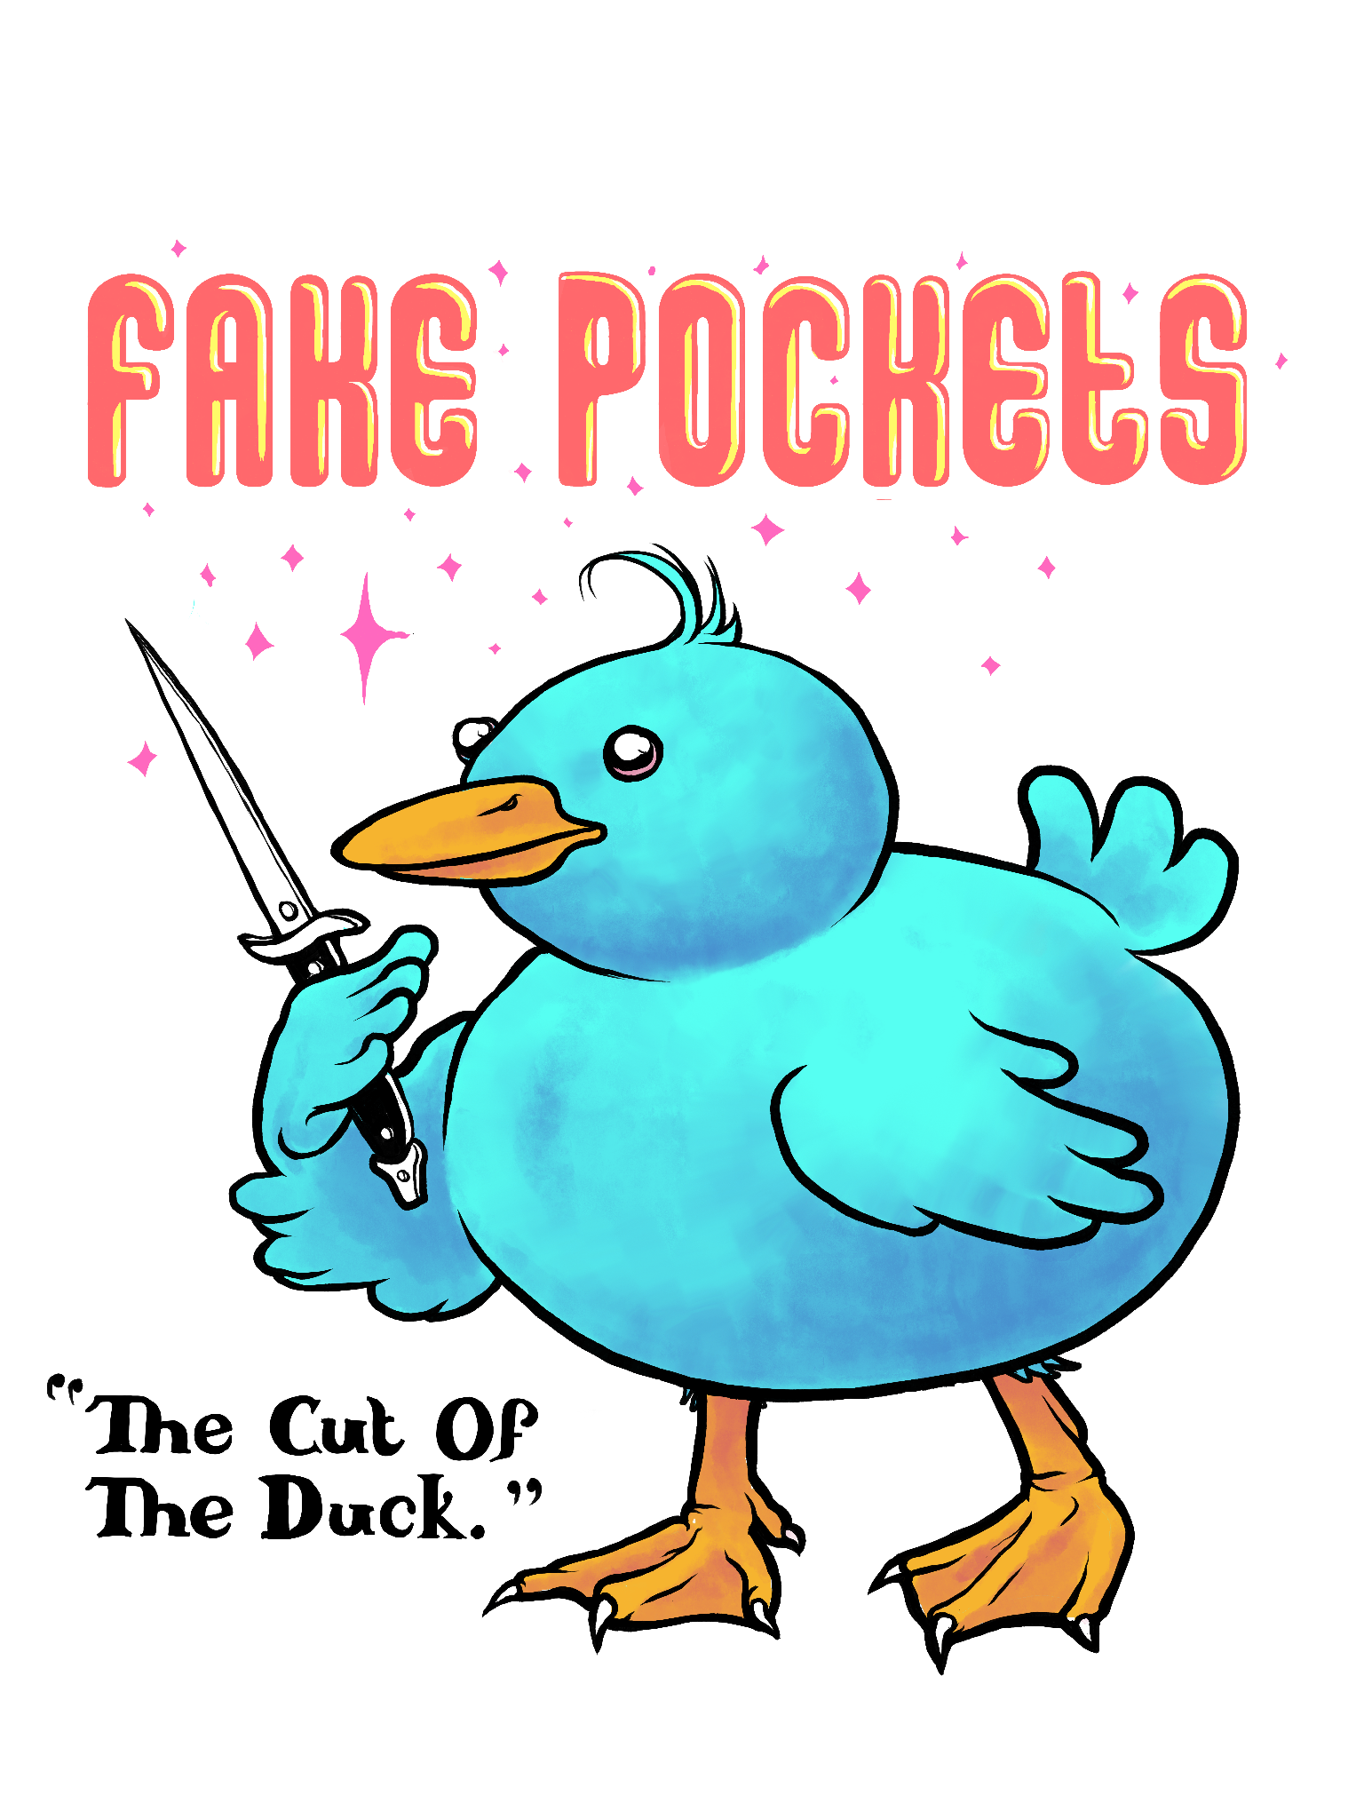
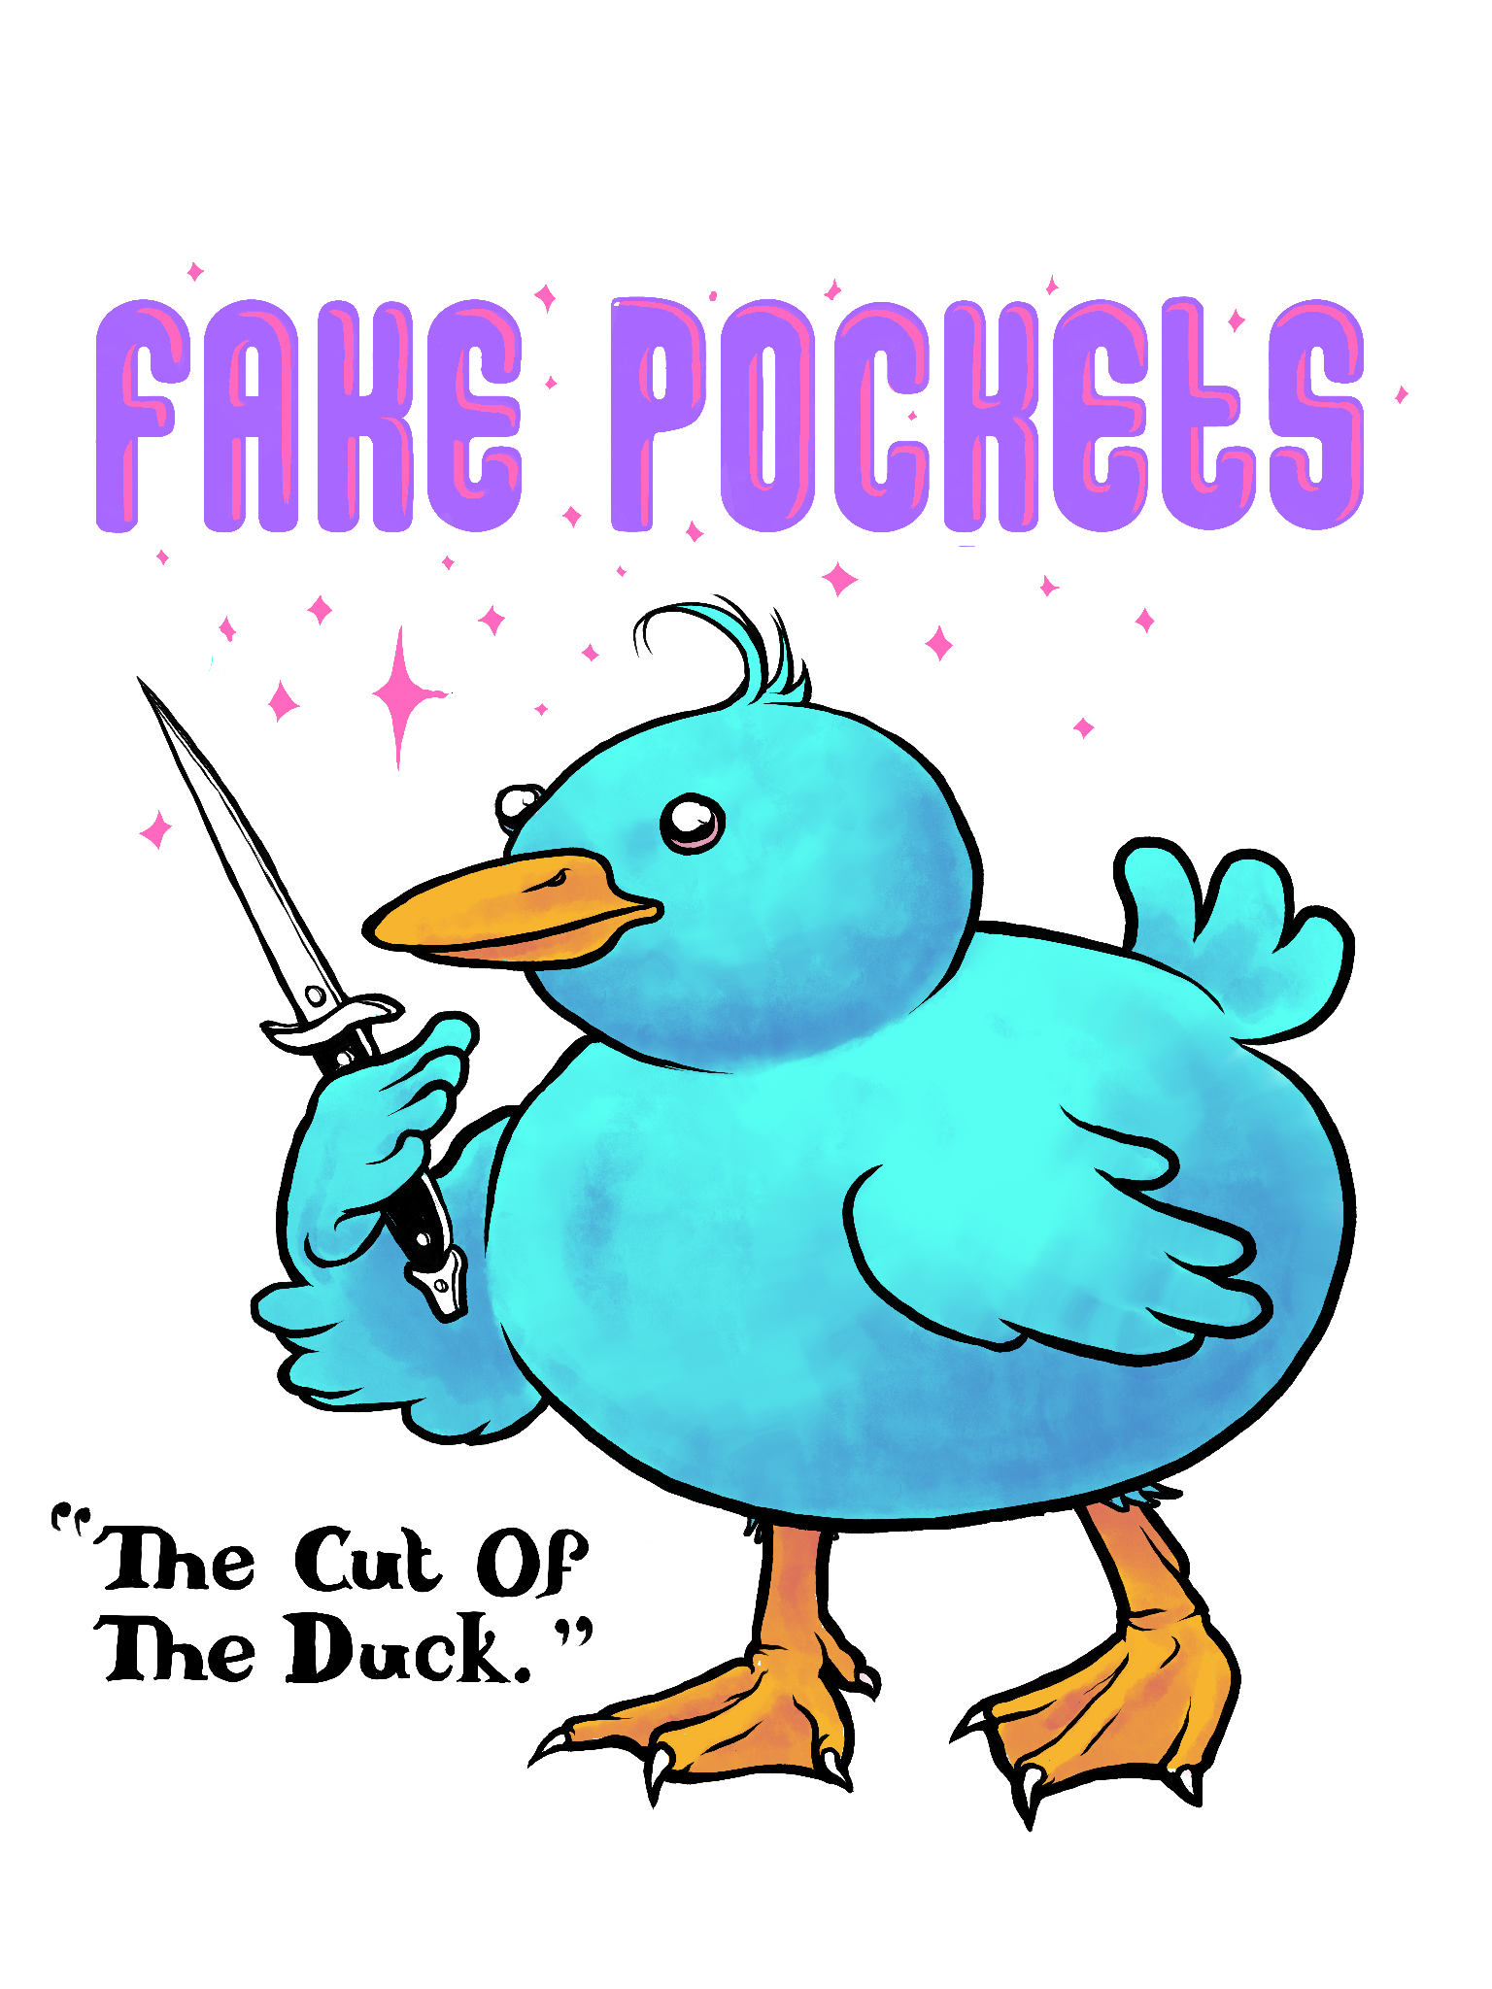
Color Duck - Color Type
#21
#20

Slide 14
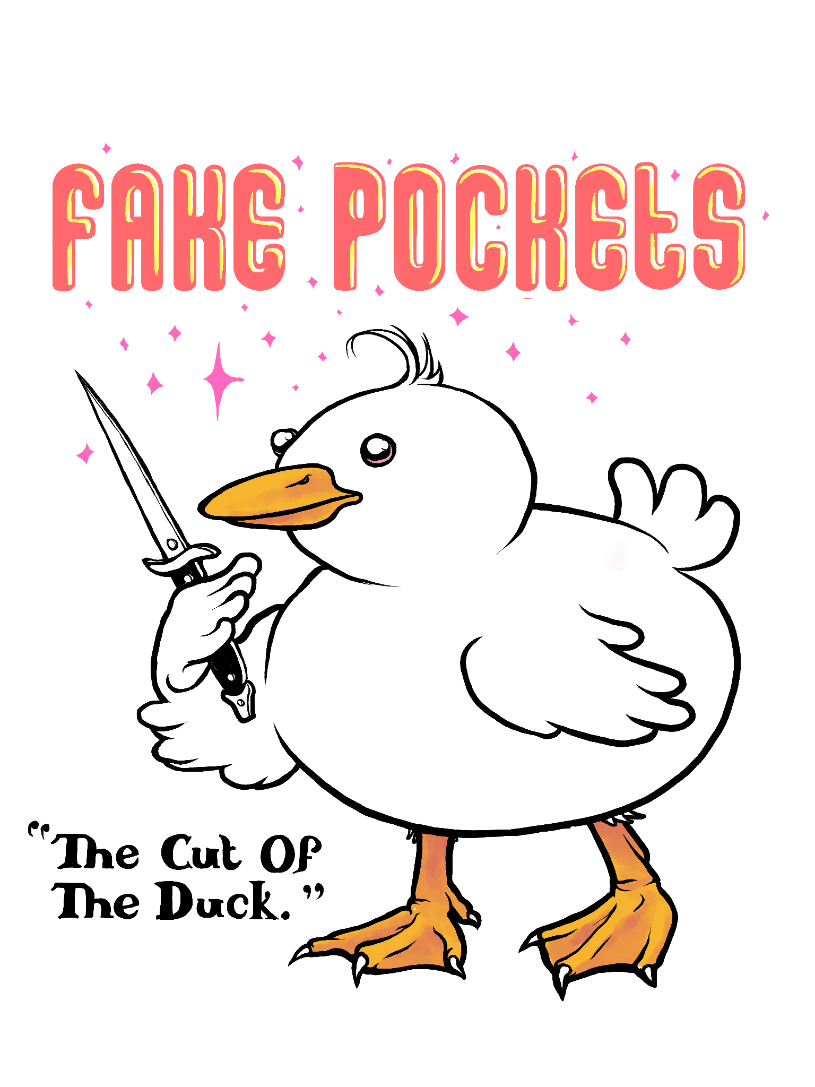
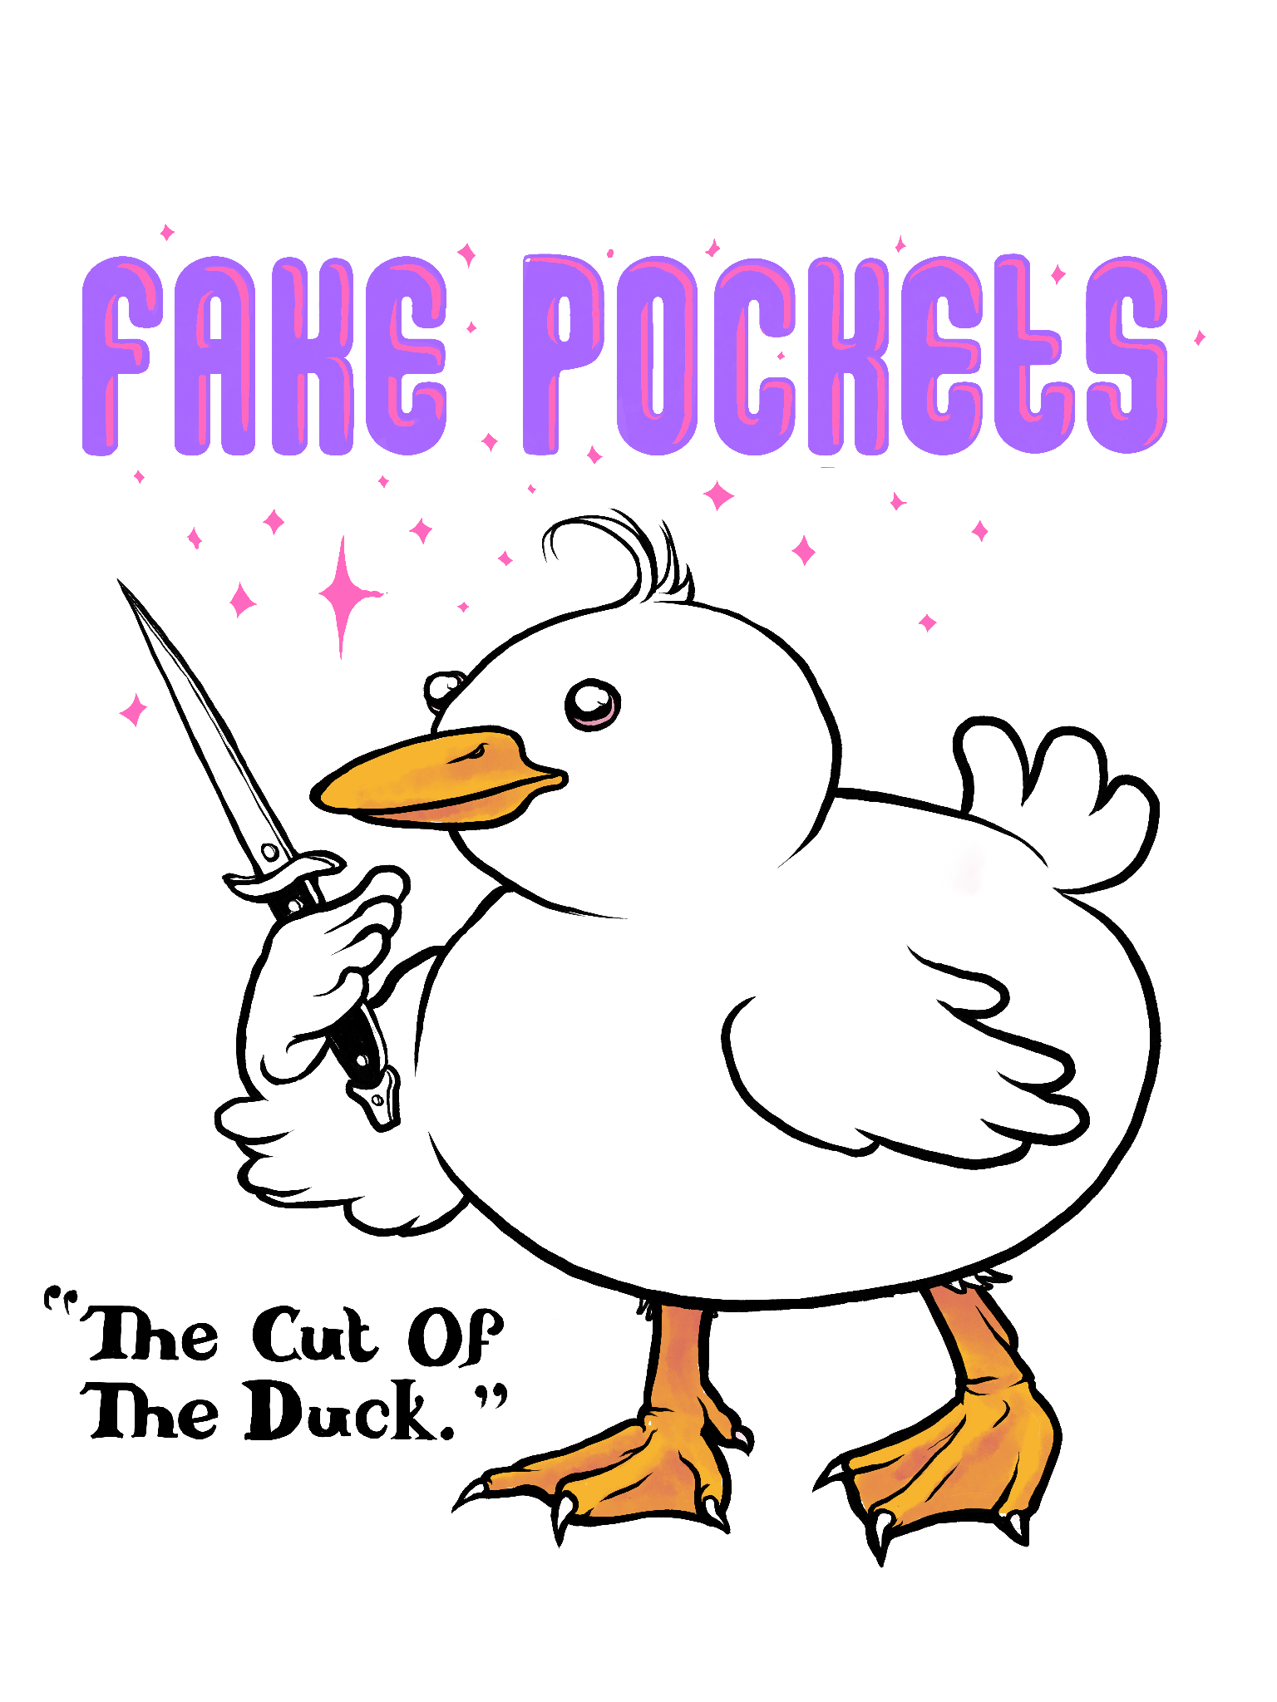
Color Duck - Color Type
#23
#22

Slide 15
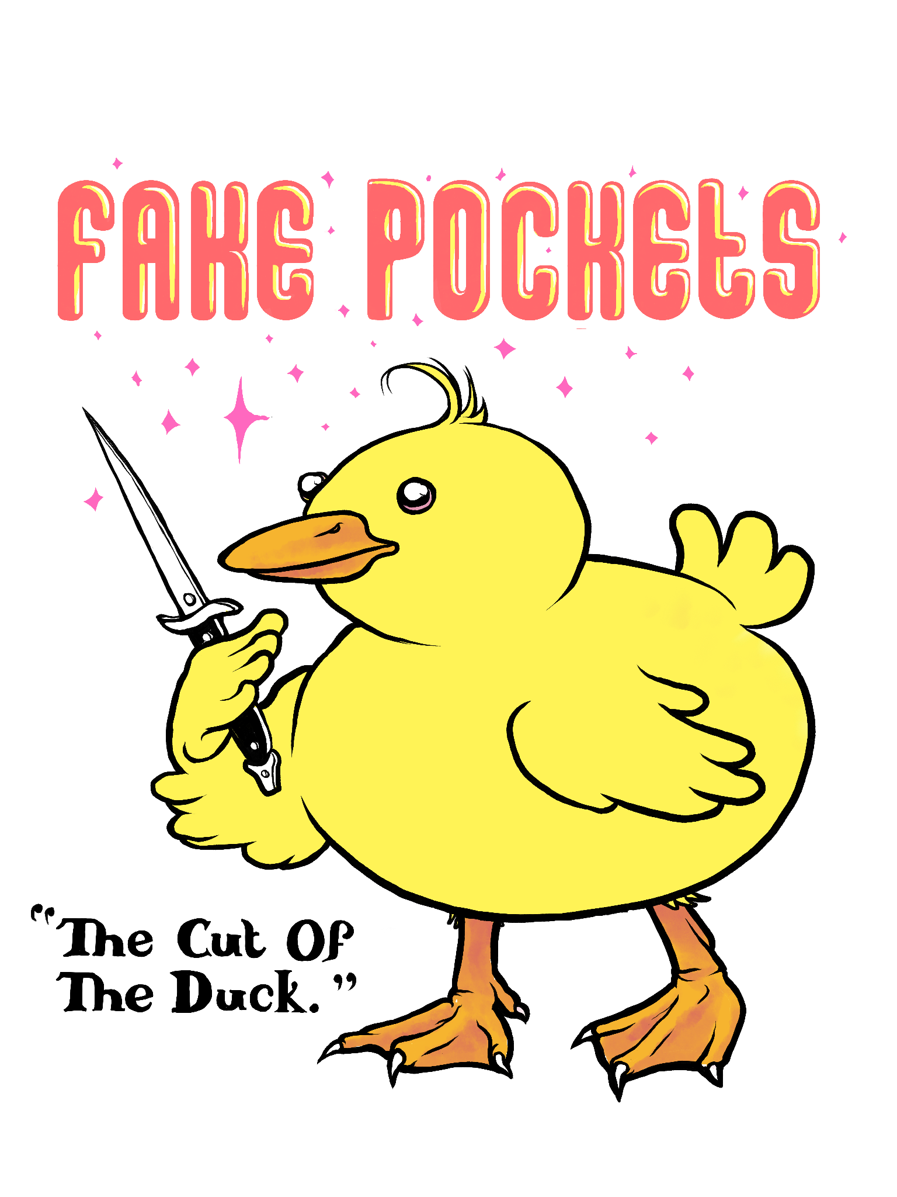
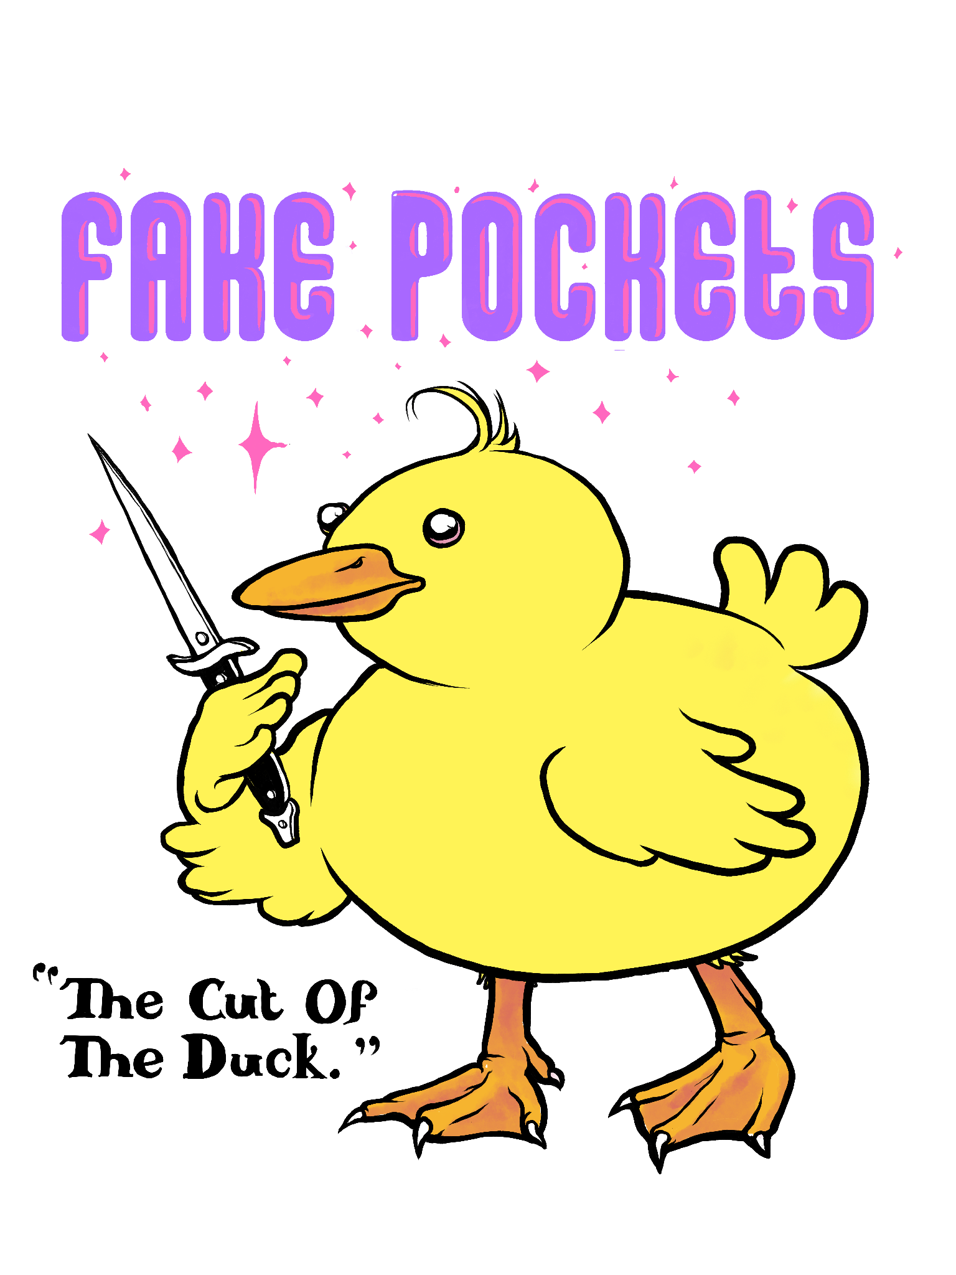
Color Duck - Color Type
#25
#24

Slide 16
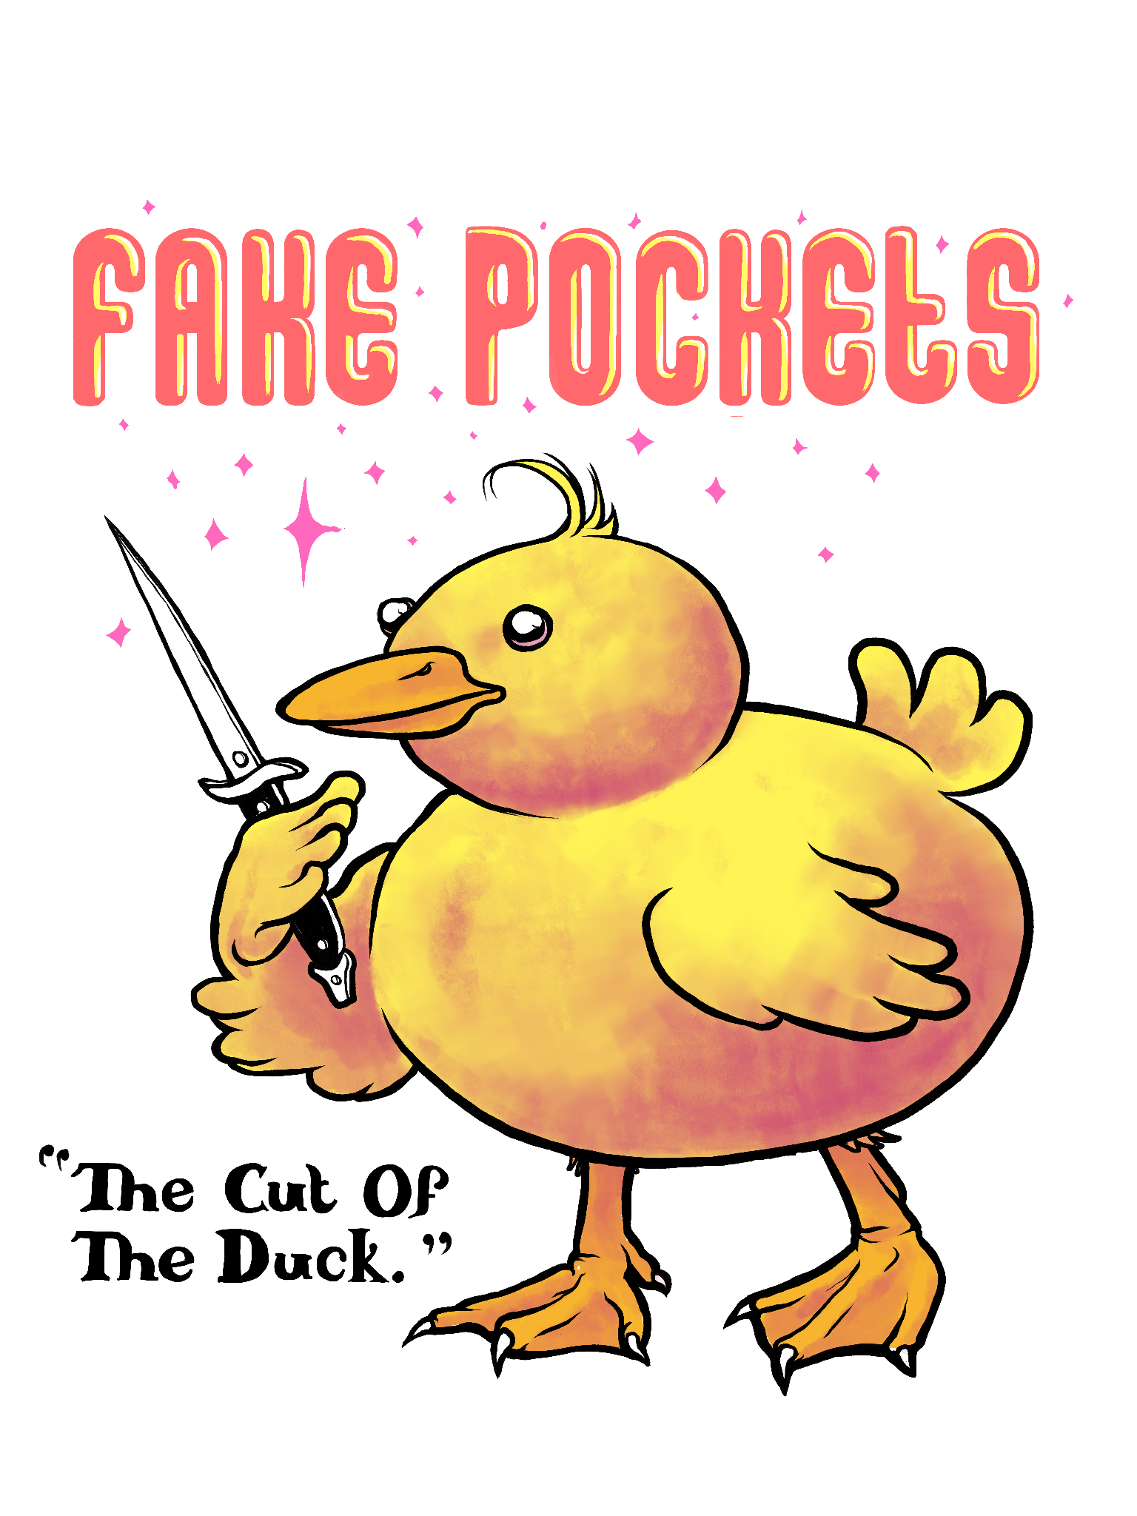
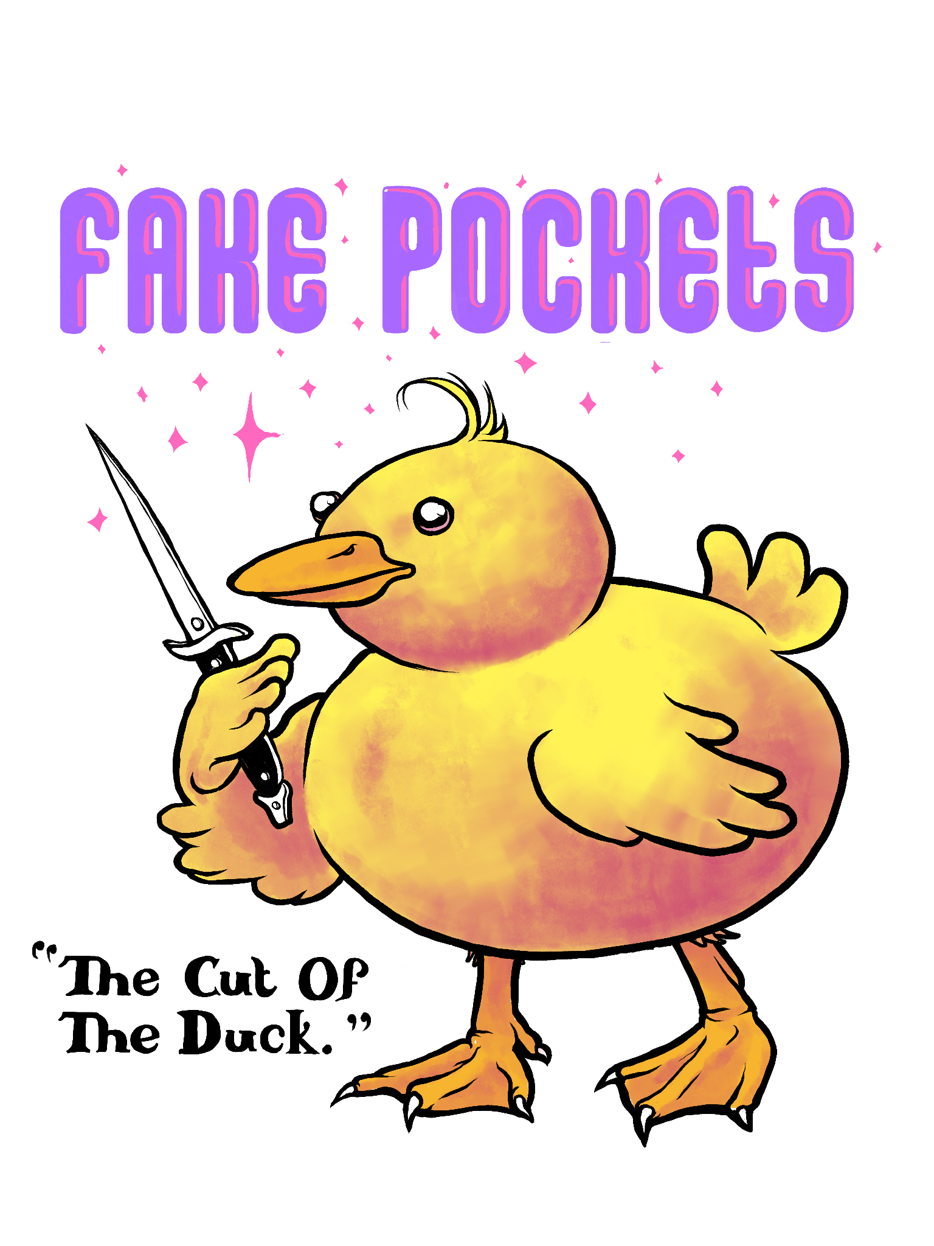
Color Duck - Color Type
#27
#26

Slide 17
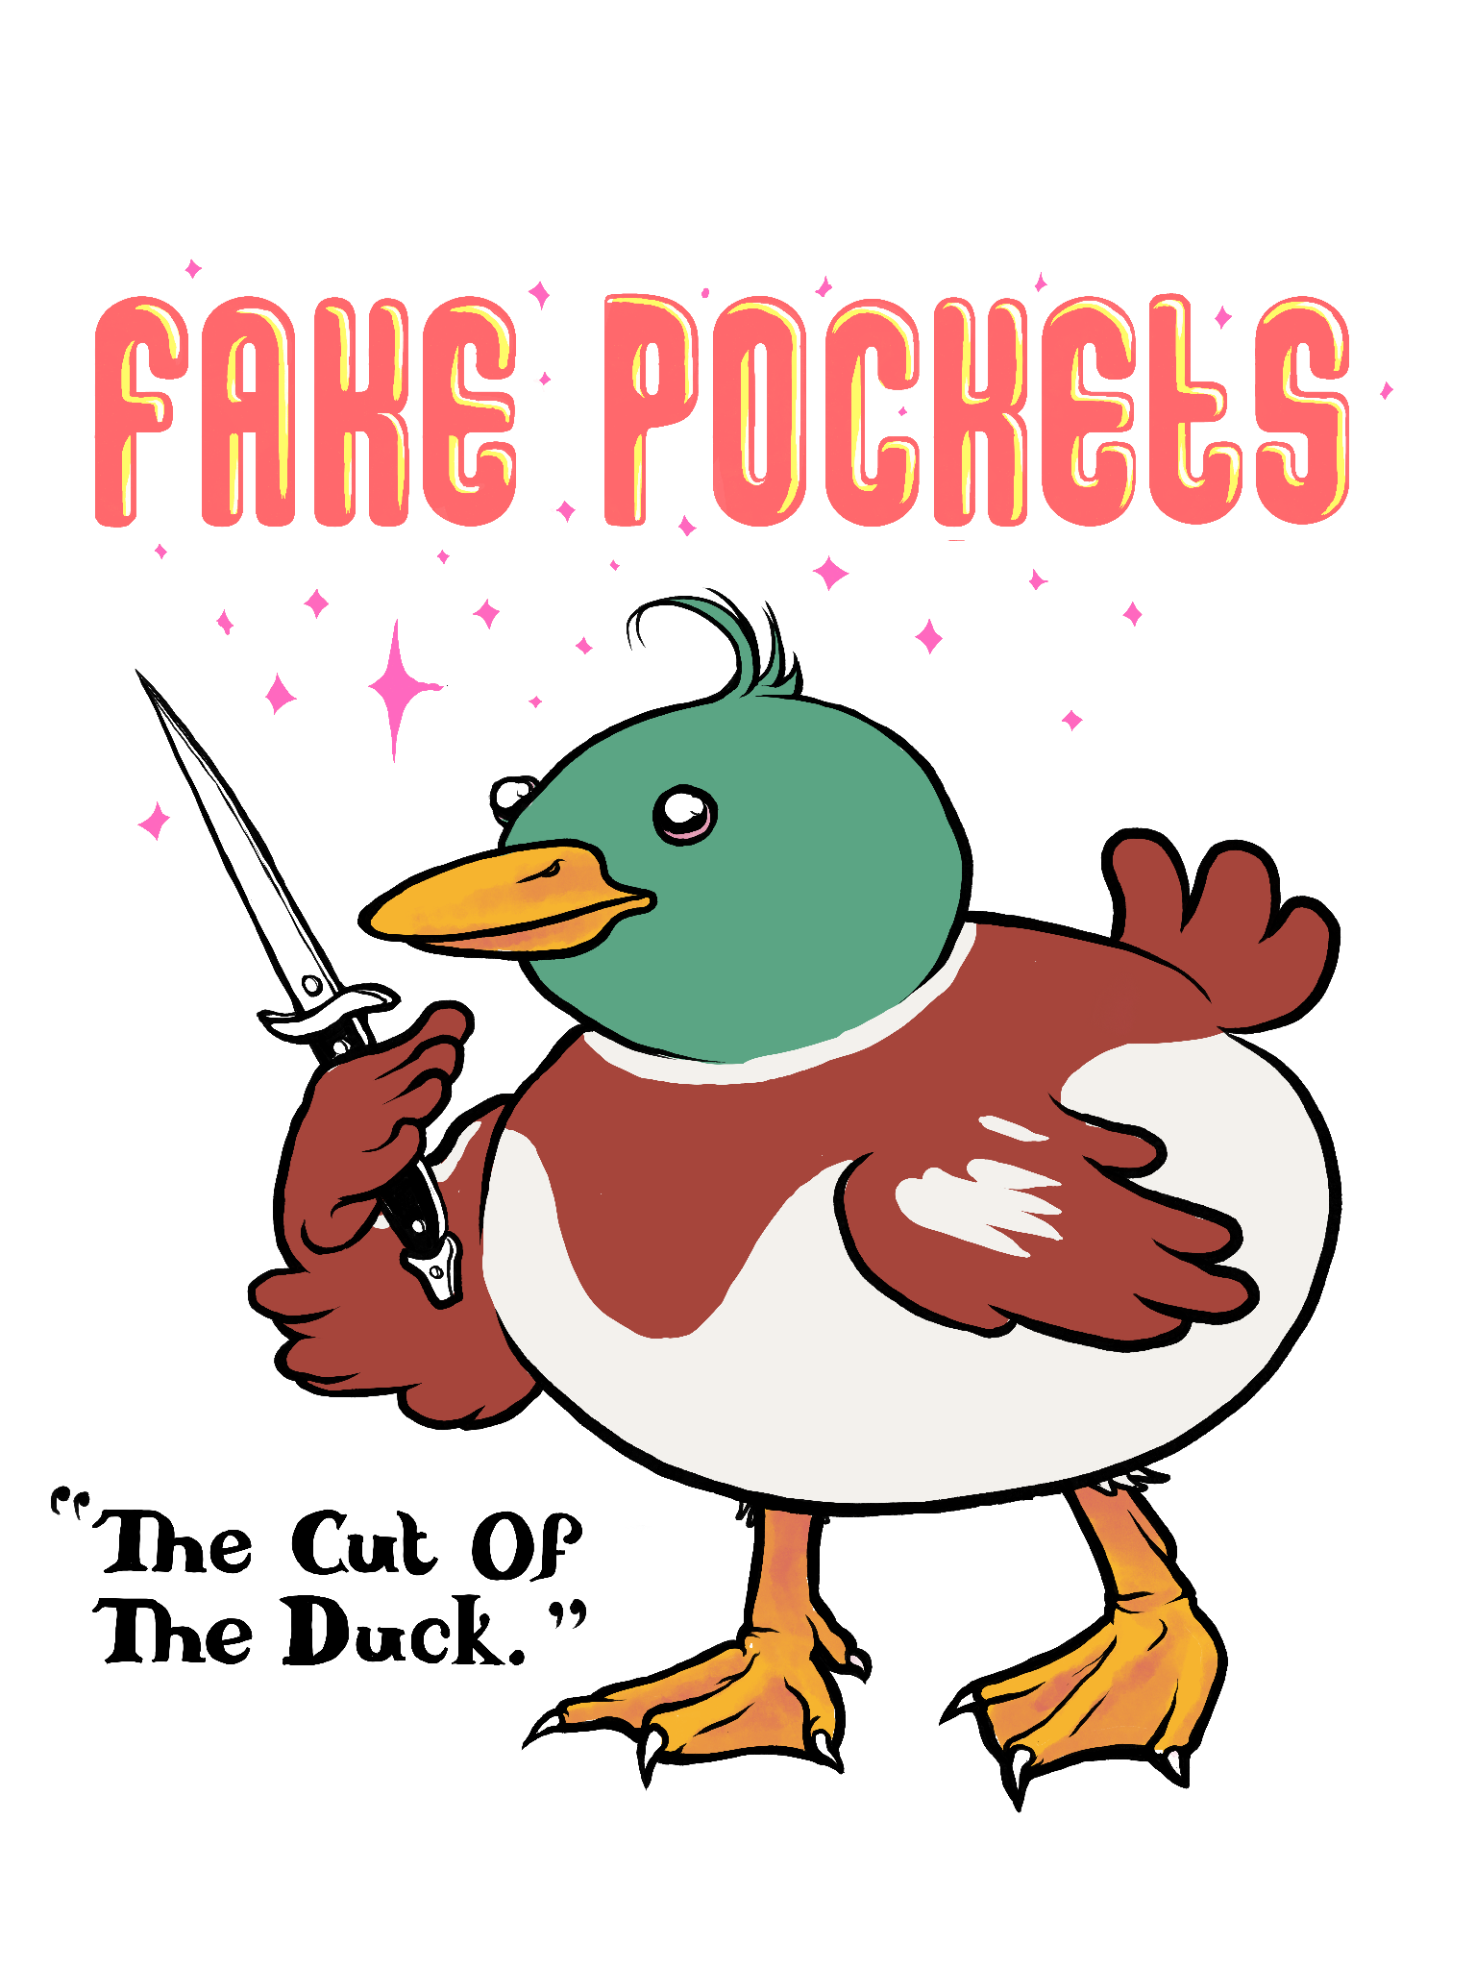
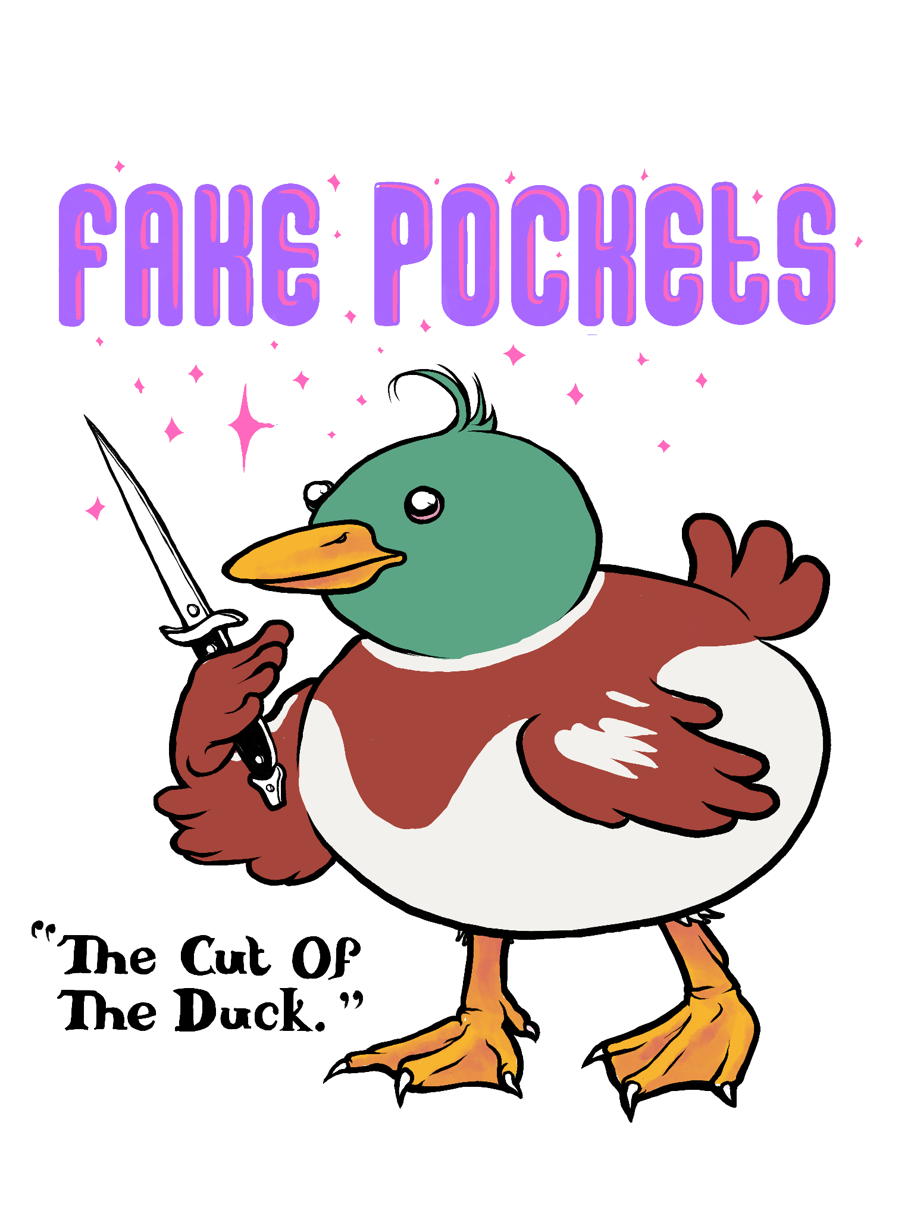
Color Duck - Color Type
#29
#28

Slide 18
Final Selections
(FAKE POCKETS)
SHIRT DESIGN

Slide 19
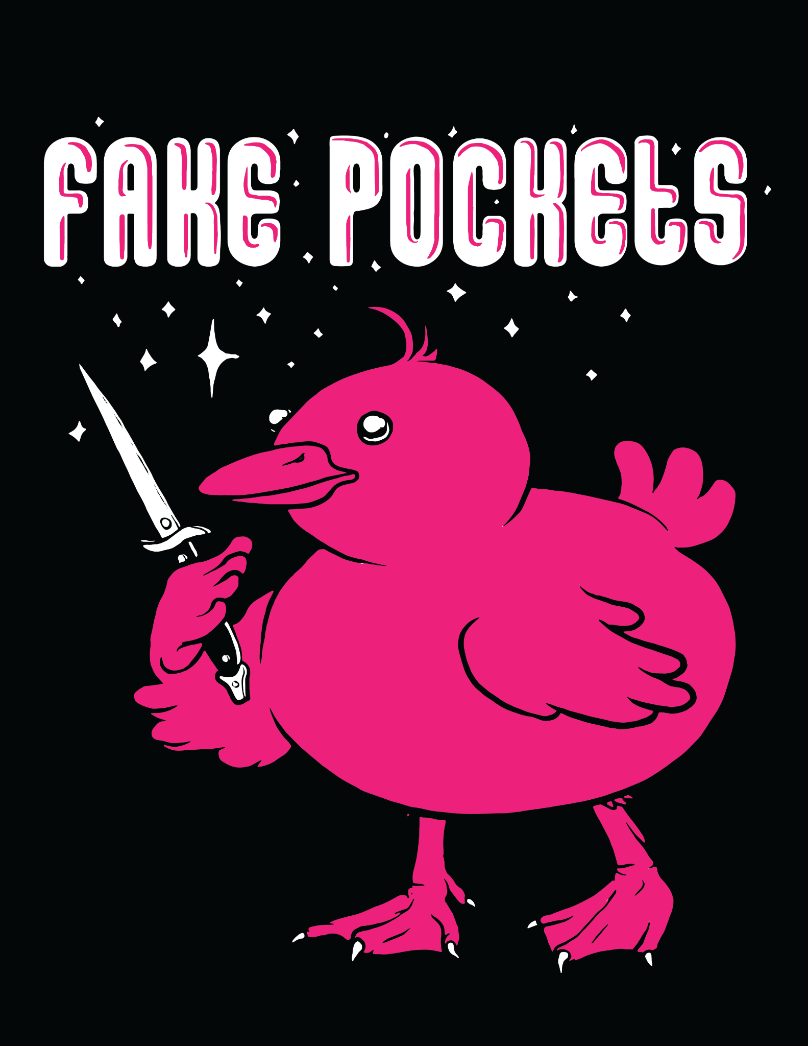
2 Color Duck on Black Shirt
#31
#30

Slide 20
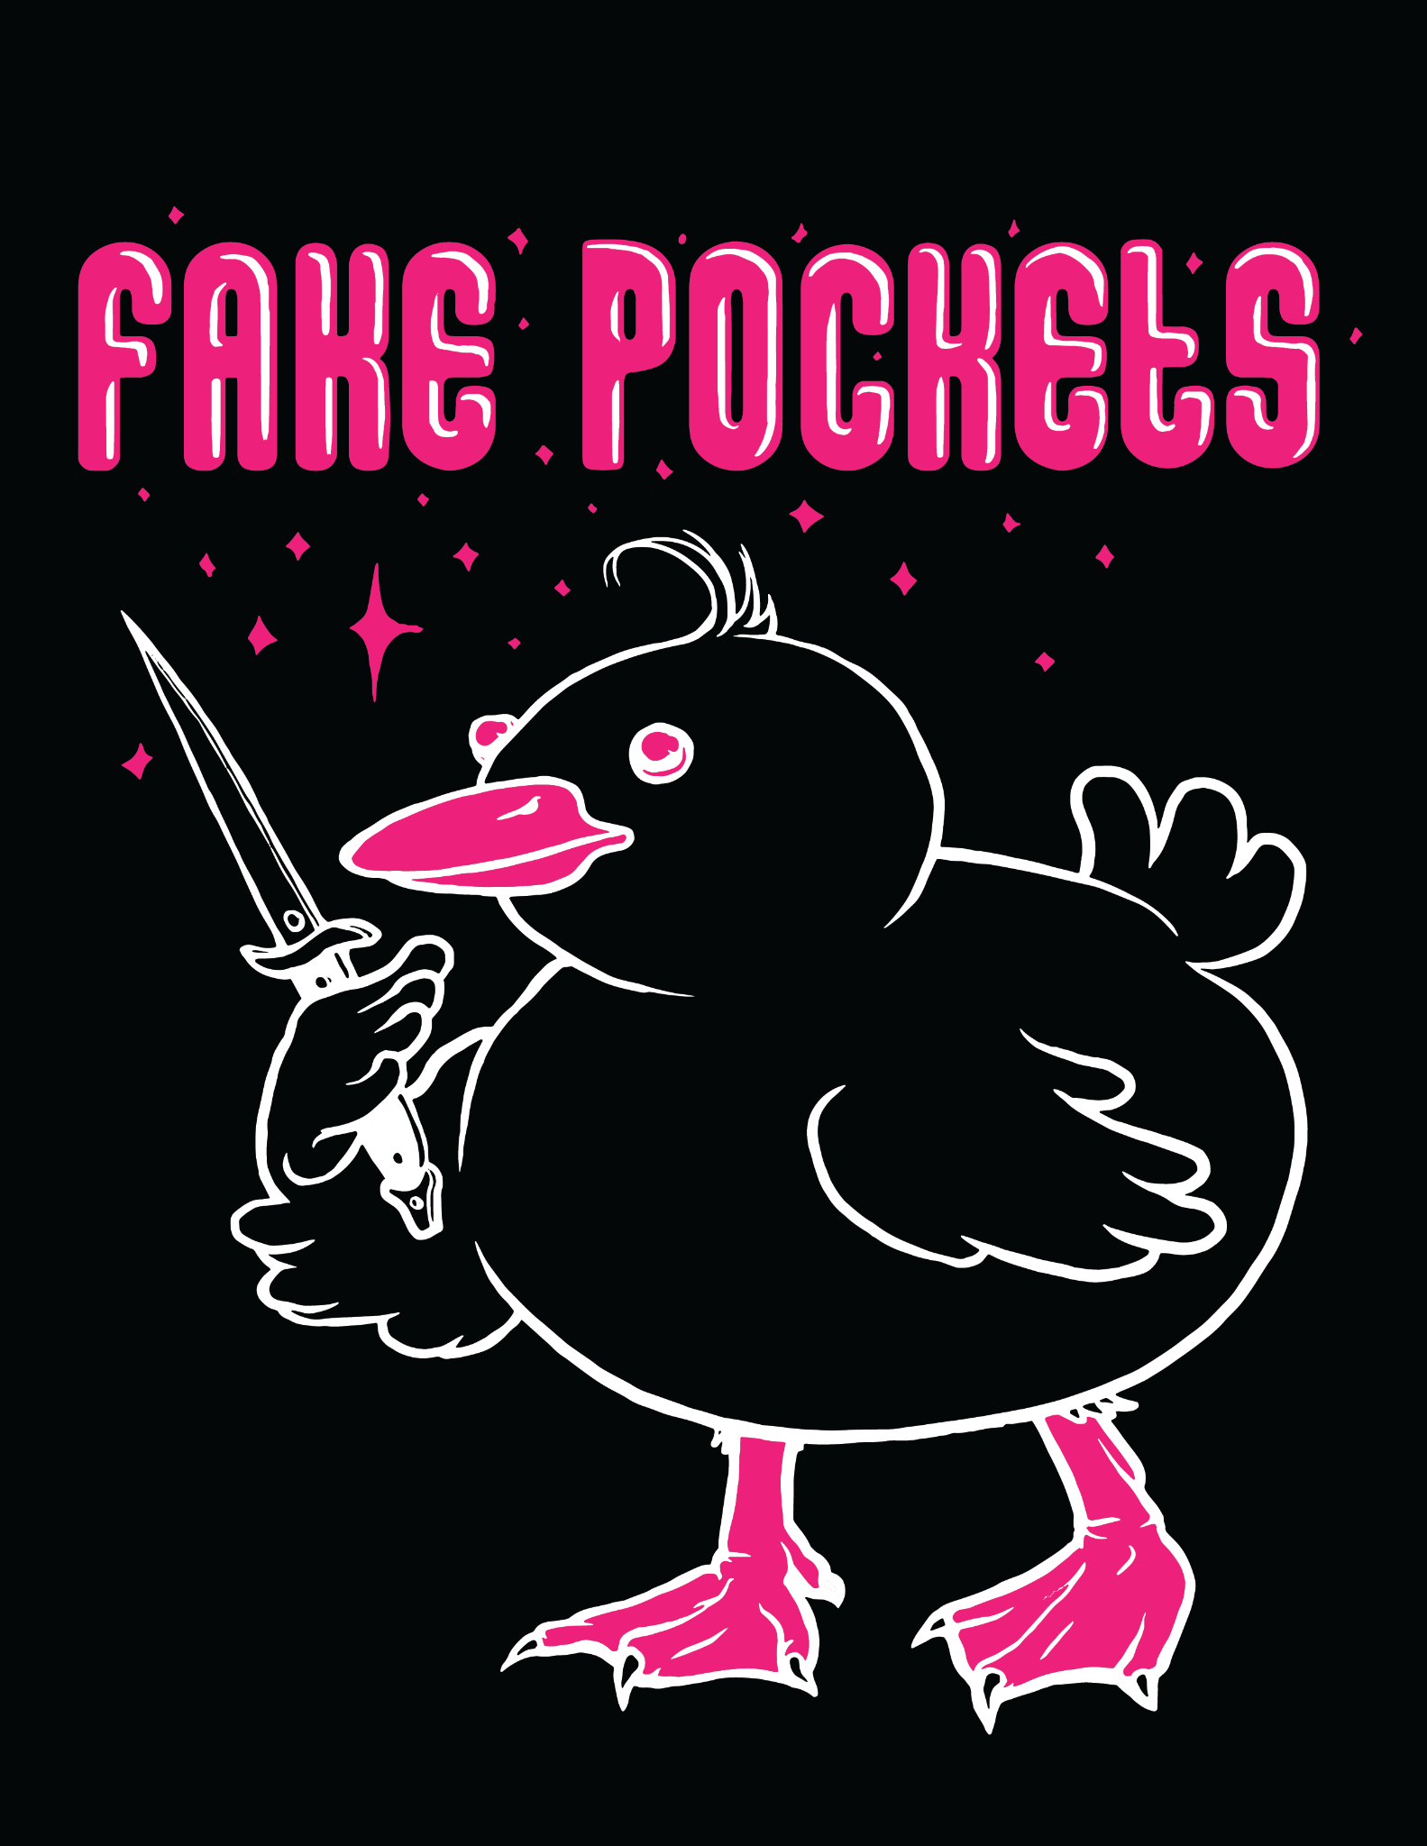
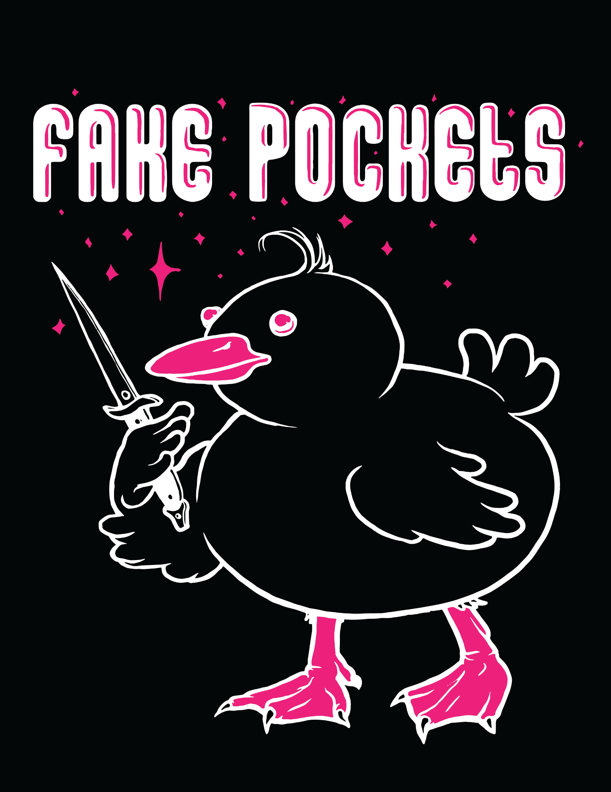
2 Color Duck on Black Shirt
#33
#32
Notes:
Hiiiiiiiii

Slide 21
FINAL
#33
Notes:
Hiiiiiiiii

Slide 22
FILES:
( https://drive.google.com/drive/folders/1pFiOLHDpmoyQrmYV31O1YPLhD3LenCQe?usp=sharing )
#30 - #33 Vectorized on the above illustrator file.

Slide 23
END

